Slide 1
Guide on PipeXpress Plus Usage
Created by :
Alan Ang
Snr BD Manager For APAC
Slide 1

Slide 2
How to install Pipe Xpress Plus
System requirements
Operating system: Microsoft Windows 10 or higher
Software platform: Microsoft .NET Framework 4.7.2 or higher
CPU: at least 2 GHz
RAM: minimum 4 GB
Screen resolution: minimum 1366 x 768 px
Free memory space: at least 500 MB
Preparing the installation
Check the system requirements (see System requirements).
Deinstall all earlier versions of the software.
Close all open programs.
The installation preparation is completed.
Installing the software
Start the installation software SetupPipeXpressPlusVxxxxxxxxxx.exe with a double click.
Follow the instructions on the screen and click on Next.
All files are copied to the hard drive.
Once the installation is completed, confirm this message with Finish.
The software is installed.
You can start the TITANUS PipeXpress® Plus by using the desktop symbol or the start menu.

Slide 3
All About Titanus Pipe Xpress Plus Project Planner
Software description
With TITANUS PipeXpress® Plus you can plan a pipe system for TITANUS® air sampling smoke detectors from WAGNER and have values such as the drawn air volume, transport times and the sensitivity of the individual air sampling points.
Pipe planning assistant
The pipe planning assistant guides you through the entire pipe planning and helps you to create pipe project plans. The pipe planning assistant then passes on the planned pipe system to the editor. In the editor, you can continue editing the pipe system or have it calculated.
Calculations
In the calculations, TITANUS PipeXpress® Plus takes into account the pipe diameter, the positions and sizes of the air sampling points as well as the planned pipe accessories such as filters or condensate separators. In addition, environmental parameters such as temperature and air pressure of the project location are integrated.
The software has various calculation modes for different project plans (see Calculation modes).
Certificate of conformity and protocol
The output of the calculation results is compared with the specifications of the selected project planning standard in order to assess conformity.
If all specifications of the selected standard are fulfilled, you can produce a certificate of conformity for the pipe project plan with TITANUS PipeXpress® Plus.
If not all specifications of the selected standard are fulfilled, you can produce a protocol for the pipe project plan with TITANUS PipeXpress® Plus.
Material list
TITANUS PipeXpress® Plus can put together a complete material for an order with WAGNER for the planned pipe system.

Slide 4
Various Related Calculation modes built in Option
Calculation modes
Various calculations for different project plans are possible with the software. The buttons of the calculation modes can be found in the toolbar of the editor .
Calculation mode for existing pipe systems
In the calculation mode for existing pipe systems, you can calculate a pipe system that has already been designed if the diameters of the air sampling points have already been defined.
The software determines the maximum transport time, the balance as well as the minimum and maximum sensitivity per air sampling point.
Automatic calculation mode for new pipe systems
In the automatic calculation mode, you can automatically calculate a new pipe system. The software determines the diameter of the air sampling points under compliance with the specified balance and transport time.
Calculation of the manual air purge and automatic air purge system
If you use a manual air purge or an automatic air purge, the software can calculate the pressure at the sampling and acceleration points as well as at the ends of the pipe system.
In addition, the required compressed air supply is determined.

Slide 5
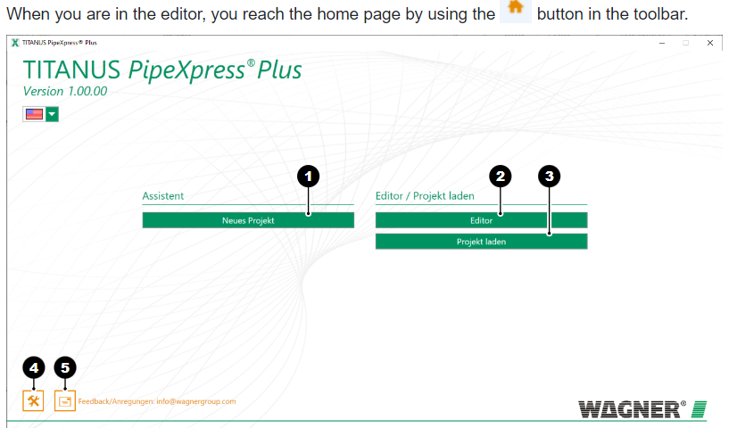
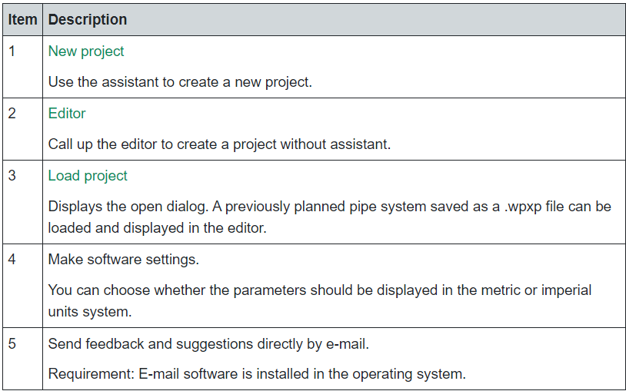
After Starting PipeXpress Plus
User Interface Key Menu
Home page
Pipe planning assistant
Editor
Calculation results
Certificate of conformity and protocols

Slide 6
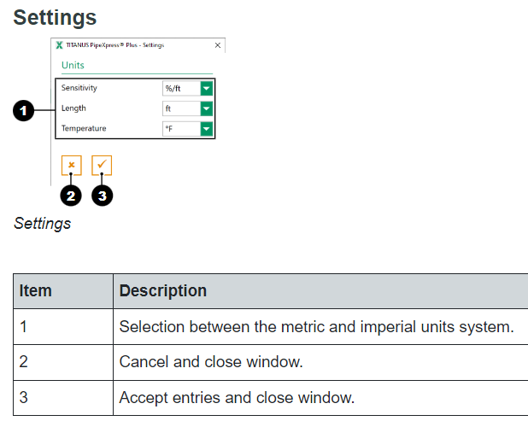
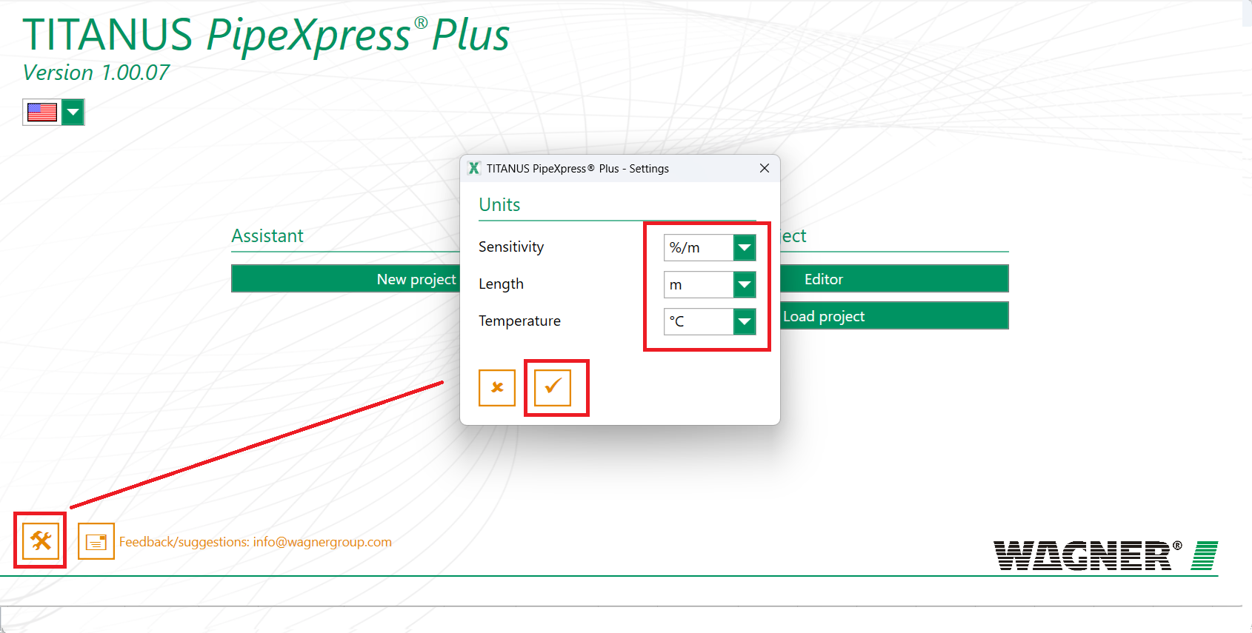
Click at bottom left icon and set units as per required for Sizing

Slide 7
The below menu are necessary steps to assist completing the project planner for Aspirating Smoke Detection Design.
Pipe planning assistant
The pipe planning assistant guides you through the entire pipe planning and helps you to create pipe project plans. The pipe planning assistant then passes on the planned pipe system to the editor. In the editor, you can continue editing the pipe system or have it calculated.
Further information
Normative specifications
Pipe and application
Detector selection
Detectors and accessories
Pipe system definition
Pipe supply lines
Pipe branches
Filter and detector box

Slide 8
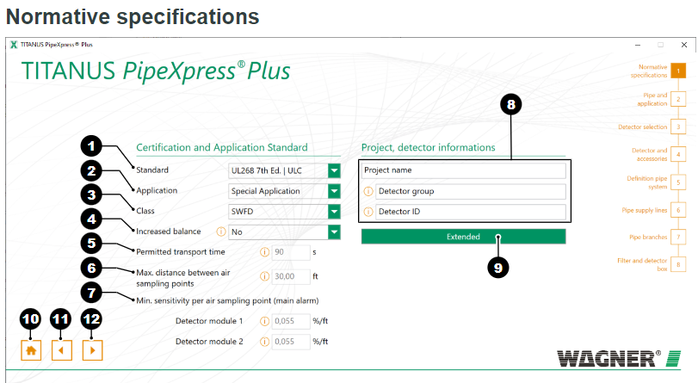
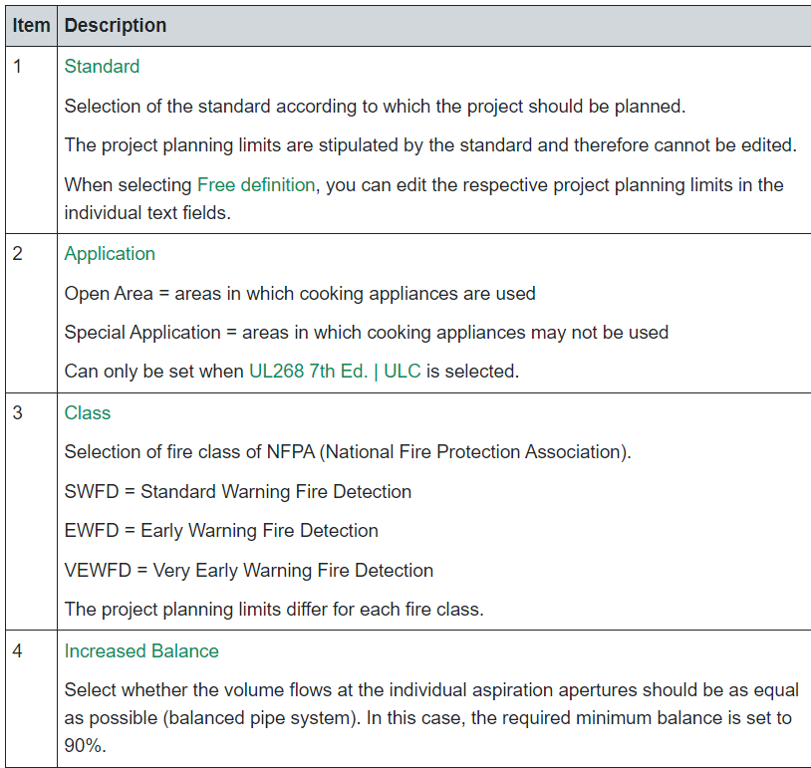
Step 1: Normative Specification (Basic Systems Groundwork Requirements)
In the segment Certification and Application Standard (1), select a standard or Free definition.
If you have selected UL268 7th Ed. | ULC:
Choose Open Area as the application if cooking appliances are used in the monitoring area or Special Application if you can ensure that cooking appliances are not used in the monitoring area.
If you have selected a standard:
Select the fire class in the selection field Class.
If required, select Increased Balance if you want to ensure that the balance is at least 90%.
If you have selected Free definition:
Specify the other parameters.
The entered values are used for calculating the project planning.

Slide 9
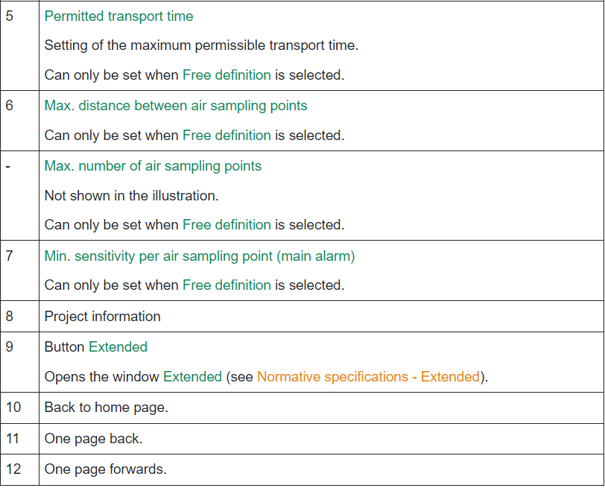
Step 1: Normative Specification (Basic Systems Groundwork Requirements)

Slide 10
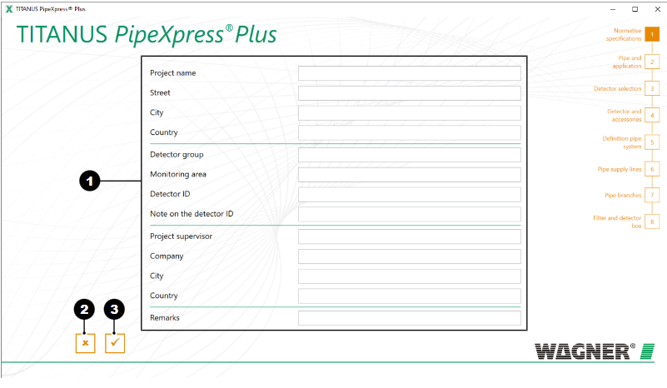
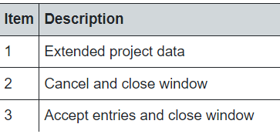
Step 1: Normative specifications - Extended (Project additional documentation)
On the page Extended there are free text fields available to you with which you can document your project. The data is adopted in the certificate of conformity.

Slide 11
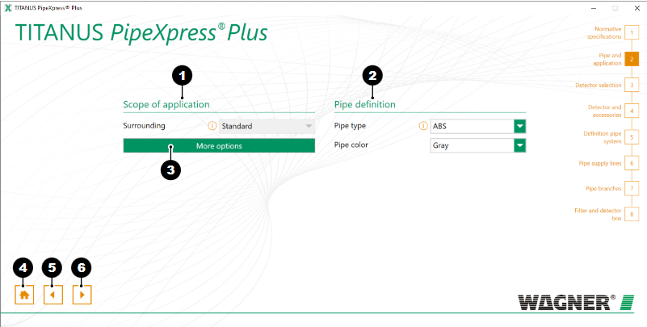
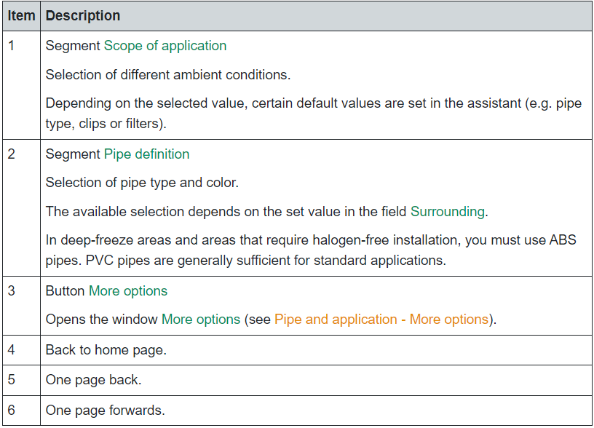
Step 2: Pipe and Application(Select types of Pipes)

Slide 12
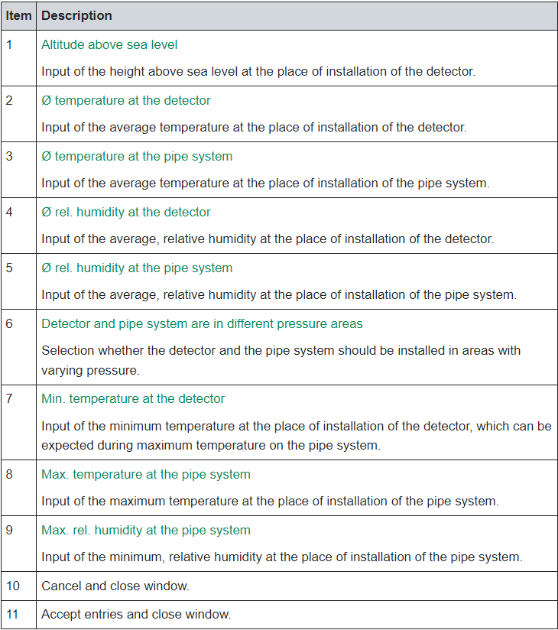
Step 2: Pipe and Application(More Option for Operating environment)

Slide 13
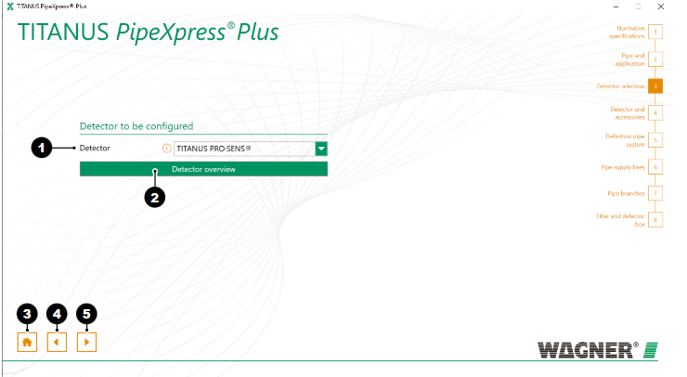
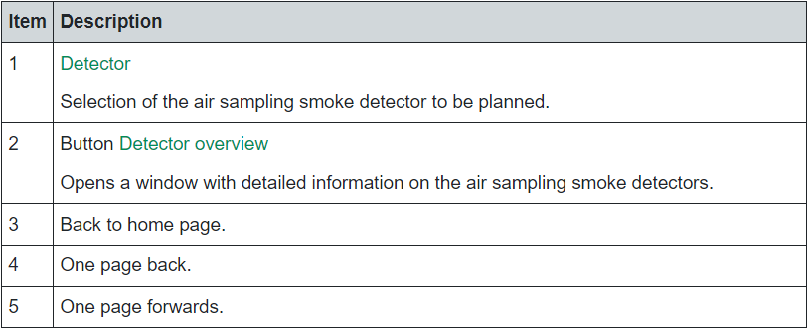
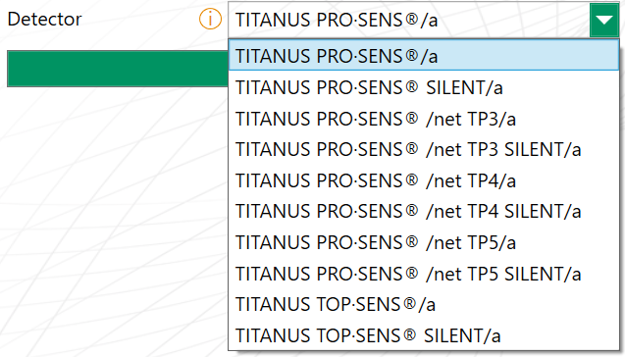
Step 3: Detector Selection(Important 1 or 2 detector and nos of Alarm and Relays)

Slide 14
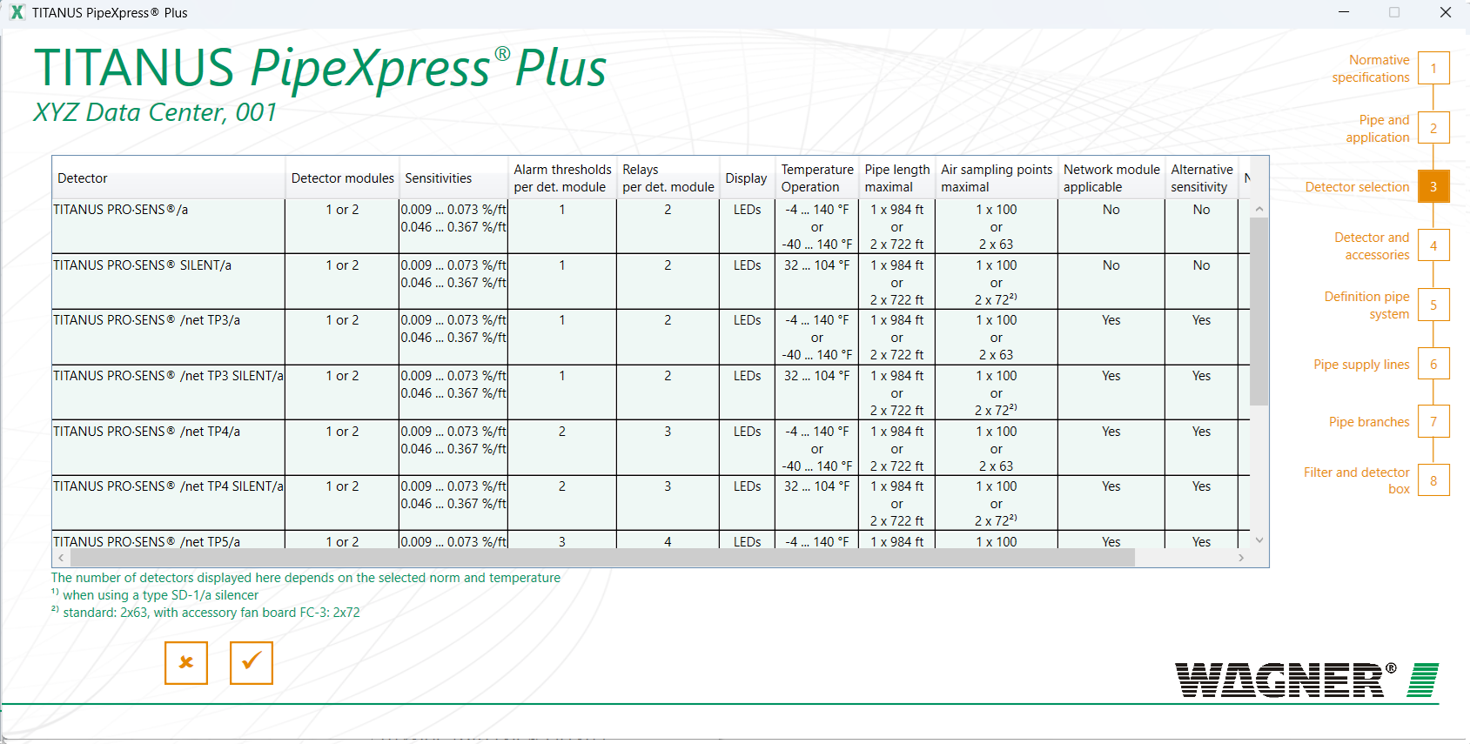
Step 3: Detector Selection- Detector Overview(Detector Details)

Slide 15
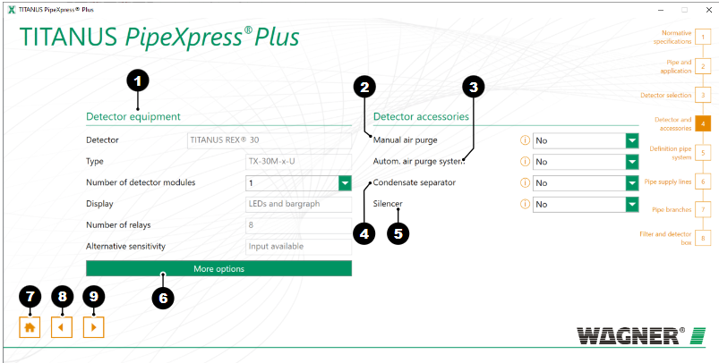
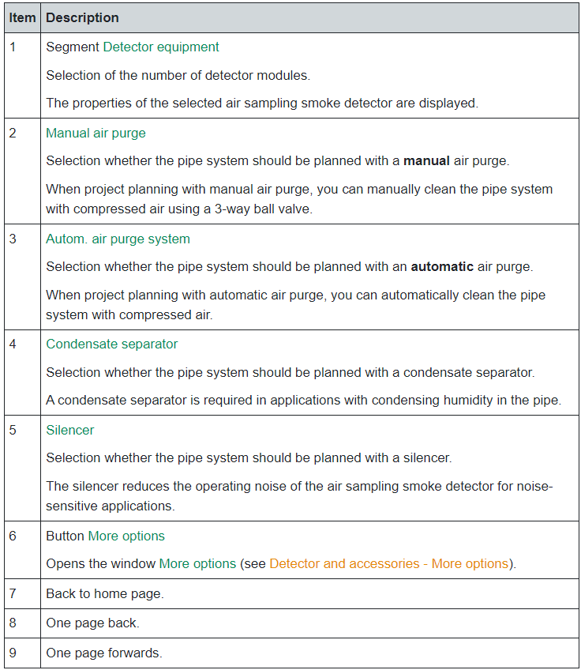
Step 4: Detector and Accessories(Nos of modules, Nos of Relays, Purging Option..etc)
Numbers of relay is crucial as the module of detector will be selected:
e.g.
2 Relays - Alarm and Fault
4 Relays – First Alarm, 2nd Alarm, Fault ..etc (To be interface to Main Fire Alarm Systems)

Slide 16
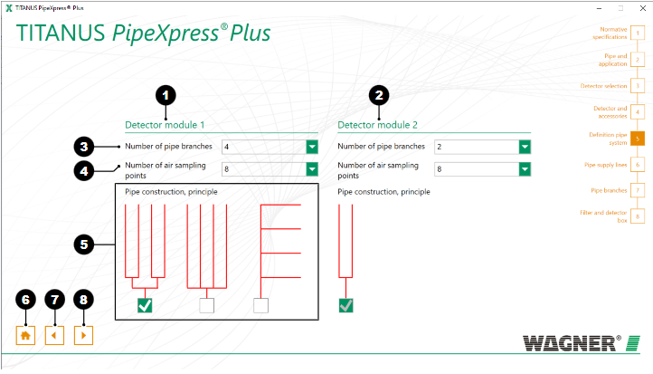
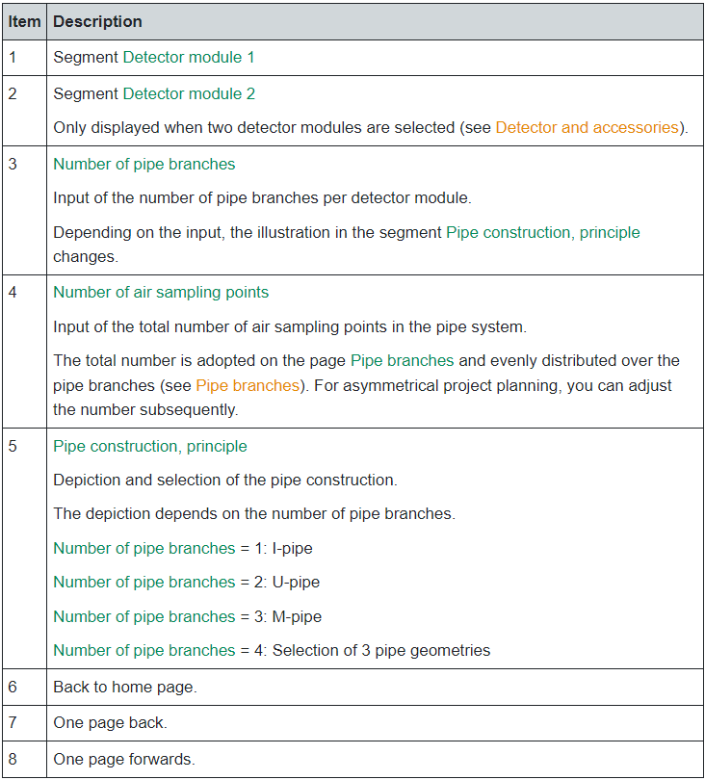
Step 5: Definition pipe system
** Note:
Pipe Construction Principle: This is key to the type of equipment you are monitoring e.g. warehouse, datacentre , hotel lobby….etc
Sampling points: It is Important to adjust the numbers of Sampling holes to align with point detector placement as a early alarm warning for ASD.

Slide 17
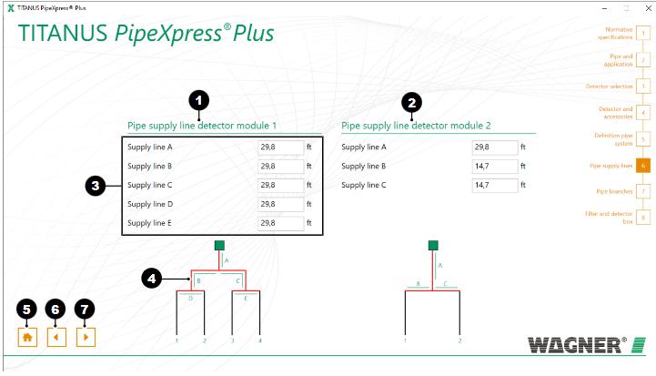
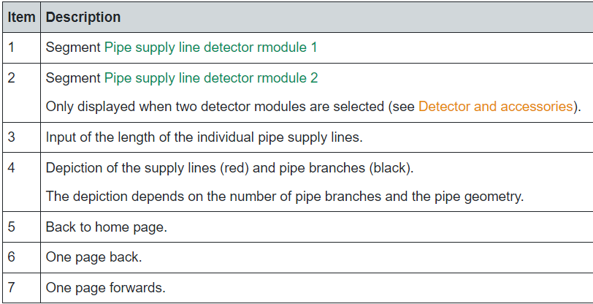
Step 6: Pipe Supply Branch( The distance of T pipes connecting to branch pipe of Sampling points)
**Note: It is important to get line A, B and C correct to ensure the Sampling holes performance as per requirements.

Slide 18
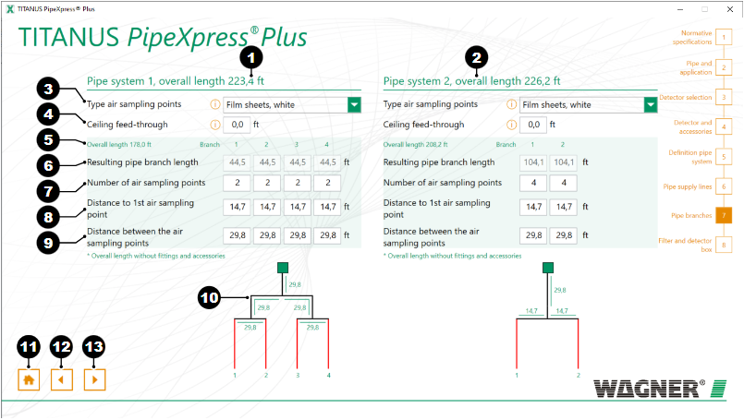
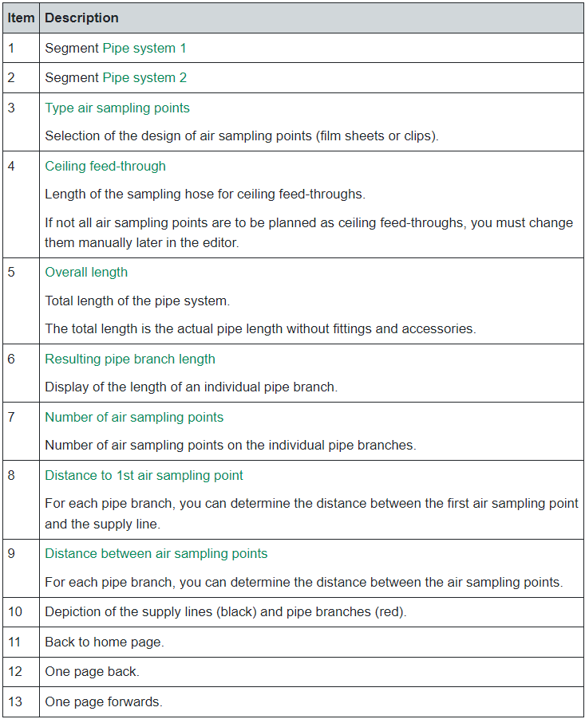
Step 7: Pipe Branches(Actual possible pipe length..etc)

Slide 19
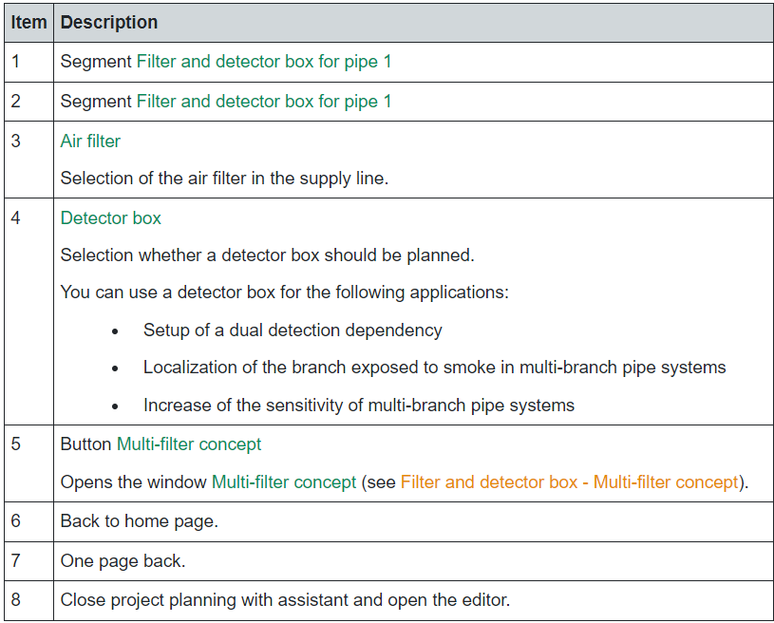
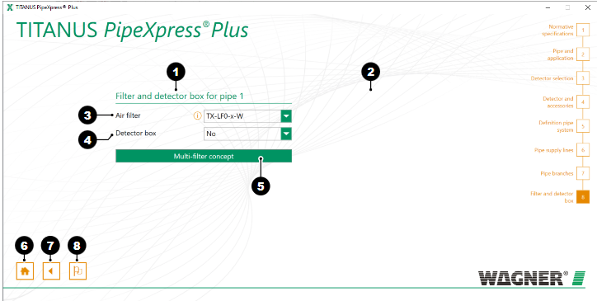
Step 8: Filter and Detector Box

Slide 20
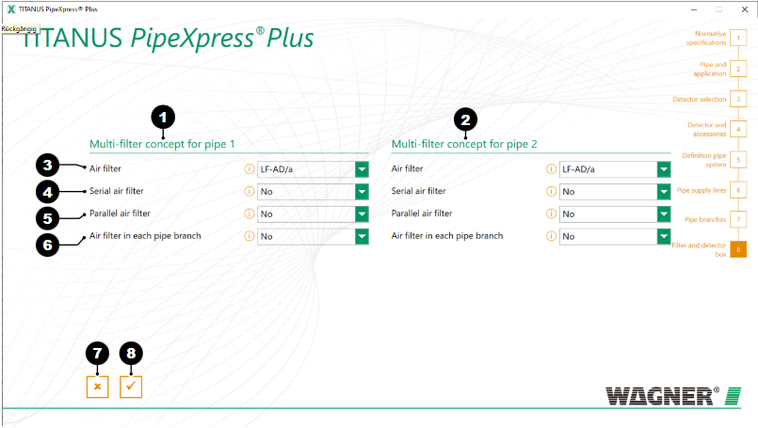
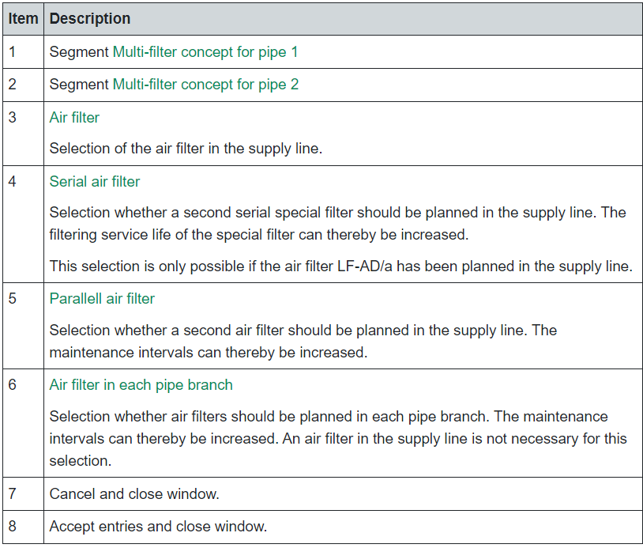
Step 8: Filter and Detector Box – Multi Filter Add on Design

Slide 21
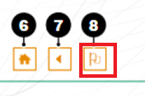
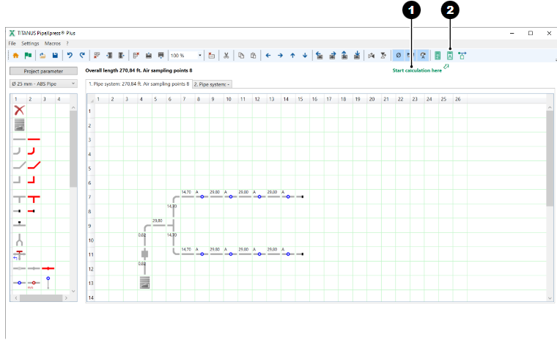
Step 9: Using Editor for Project Planning Assistant.
The page Filter and detector box is displayed. Depending on the number of detector modules (see Selecting the air sampling smoke detector features) the segments are shown for one or two detector modules.
Click on the symbol .
The editor opens.

Slide 22
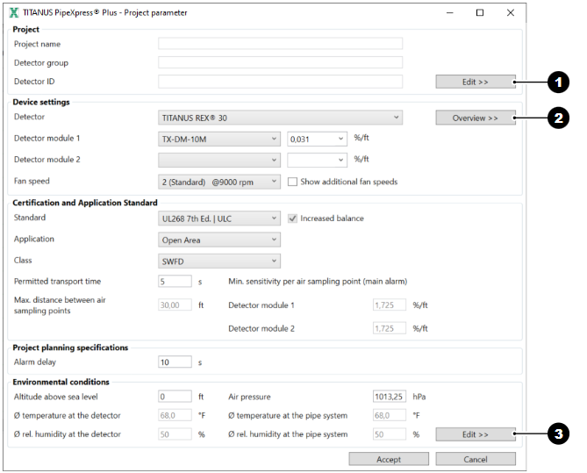
Project planning with editor
Double Check all the parameters enter with Assistant to be sure before proceeding with Editing the exact pipings and accessories.

Slide 23
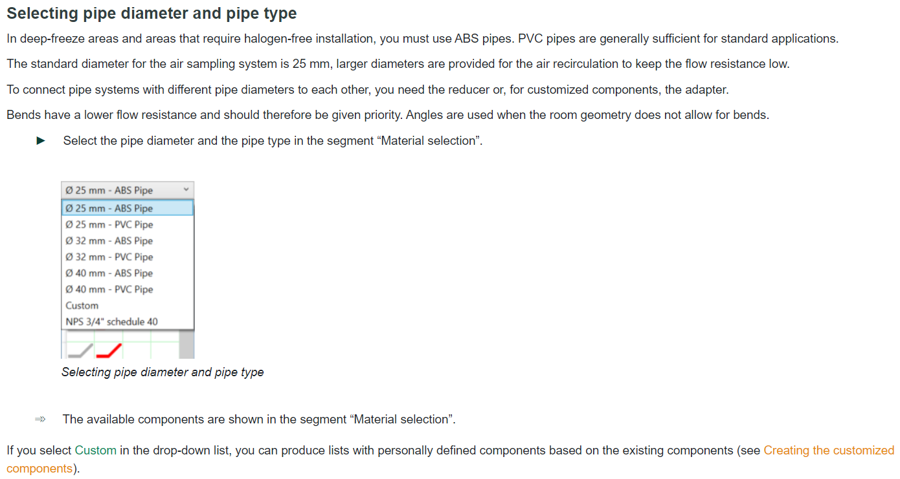
Selecting Pipe Diamter and Pipe Type

Slide 24
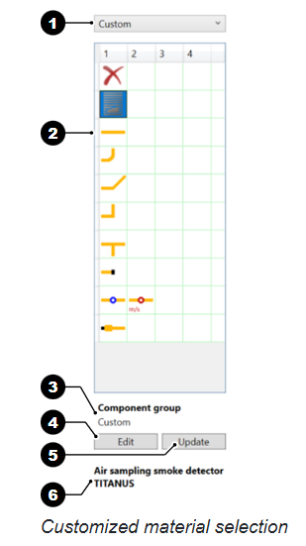
Creating the customized components
If you select Custom in the drop-down list, you can produce groups with personally defined components based on the existing components.
Customized components are displayed in yellow.
To connect pipe systems with different pipe diameters to each other, you need the adapter for customized components.
Editing components
The editor is open.
Click on the drop-down list (1) in the “Material selection” segment and choose the entry Custom.
The components (2) of the standard group Custom” (3) are displayed.
Click on the button Edit (4) to edit the properties of the components.
The window Custom opens.

Slide 25
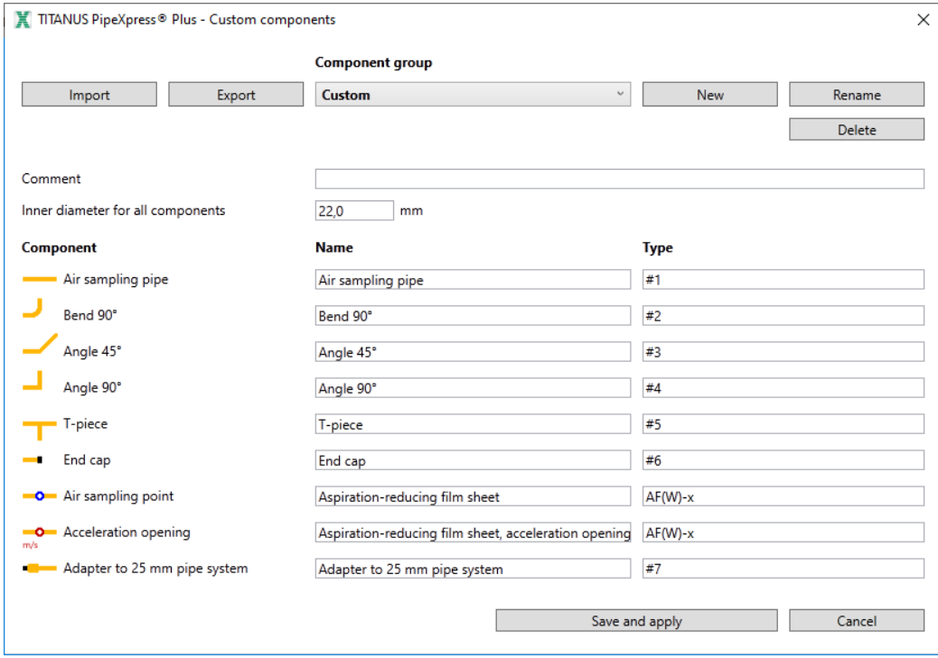
Updating Components – Create, Change, Delete, Export and Import.
Adjust the name and type of the required component.
Click on the button Save and apply.
The name and type (6) are saved in a file and displayed in the “Material selection” segment.
To update components used in the drawing area:
Click on the button Update.
The name and type are updated.
Creating a new component group
The window Custom is opened.
Click on the button New.
The input field New opens.
Enter a file name for the new component group in the window and confirm the entry with the button Accept.
The name of the component group is shown in the drop-down list Component group.
Changing the name of the component group
The window Custom is opened.
Select the component group in the drop-down list.
Click on the button Rename.
The input field Rename opens.
Enter a new file name for the component group in the window and confirm the entry with the button Accept.
The name of the component group is shown in the drop-down list Component group.
Deleting the component group
The window Custom is opened.
Select the component group in the drop-down list.
Click on the button Delete.
Confirm that you want to delete the file.
The name of the component group is removed from the drop-down list Component group.
Exporting the component group
The window Custom is opened.
Select the component group in the drop-down list.
Click on the button Export to export the selected component group.
The component group is saved in the format .ucpxp.
Importing the component group
The window Custom is opened.
Click on the button Import, to import a new component group.
The open dialog is shown.
Select the required file in the format .ucpxp and click on Open.
The name of the component group is shown in the drop-down list Component group.

Slide 26
Adding , moving Components
Adding the components on the drawing area
The editor is open.
The material list is selected.
Select the component in the material list with the left or right mouse button.
The name of the component is displayed below the material list.
Click the right mouse button on the required field in the drawing area.
The component is added.
The component name is displayed below the drawing area as long as the field is selected.
Moving the components
You can move components in various ways.
Moving with drag & drop
You can only move individual components by moving with drag & drop.
Hold down the ALT or X key and drag the component to the desired position.
The component is moved to the corresponding position.
Moving via key combinations
By moving via key combinations, you can move one or more connected components.
Mark the required component with the left mouse button.
Press the key combination Ctrl + X to cut out the selected component.
Mark the left top cell from where the cut-out area should be inserted.
Press the key combination Ctrl + V.
The cut-out area is inserted.
Moving via the toolbar
By moving via the toolbar, you can move one or more connected components.
Click the left mouse button in the drawing area on the component.
Select the desired action in the toolbar .
The component is moved by one line.
Moving by arrow keys
By moving via the arrow key, you can move several connected components only.
Use the left mouse button in the drawing area to select two or more components.
Press the arrow key with the required direction on the keyboard.
The selected components are moved by one line.

Slide 27
Calculating the pipe project planning
Calculating a new pipe system
To calculate a newly planned pipe system, you can use the automatic calculation mode.
The program determines the diameter of the air sampling points under compliance with the specified balance and transport time.
Click on the symbol .
The automatic calculation starts.
If the calculation results are within the specifications, you can produce a certificate of conformity (see Producing the certificate of conformity).
If the calculation results are outside of the specifications, you can produce a protocol (see Producing the protocols). Below the calculation results, measures appear with which you can achieve a calculation within the specifications.
Calculating an existing pipe system
If the diameter of the air sampling points in the pipe system has already been defined, you can use the calculation mode for existing pipe systems. The program determines the balance and maximum transport time.
Click on the symbol .
The calculation starts for existing pipe systems.
If the calculation results are within the specifications, you can produce a certificate of conformity (see Producing the certificate of conformity).
If the calculation results are outside of the specifications, you can produce a protocol (see Producing the protocols). Below the calculation results, measures appear with which you can achieve a calculation within the specifications.

Slide 28
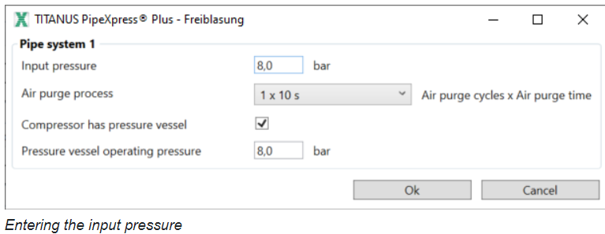
Calculating a pipe system with air purge
If you use a manual air purge or an automatic air purge, the program can calculate the pressure at the sampling and acceleration points as well as at the ends of the pipe system. In addition, the required compressed air supply is determined.
Click on the symbol .
The input window for the input pressure opens.
Enter the input pressure supplied by the connected compressed air system.
If the compressor has a pressure vessel:
Enter the operating pressure of the pressure vessel to have the minimum vessel size calculated.
Confirm the entry with OK.
The calculation starts.
You can have the calculation results displayed in a protocol (see Producing the protocols).

Slide 29
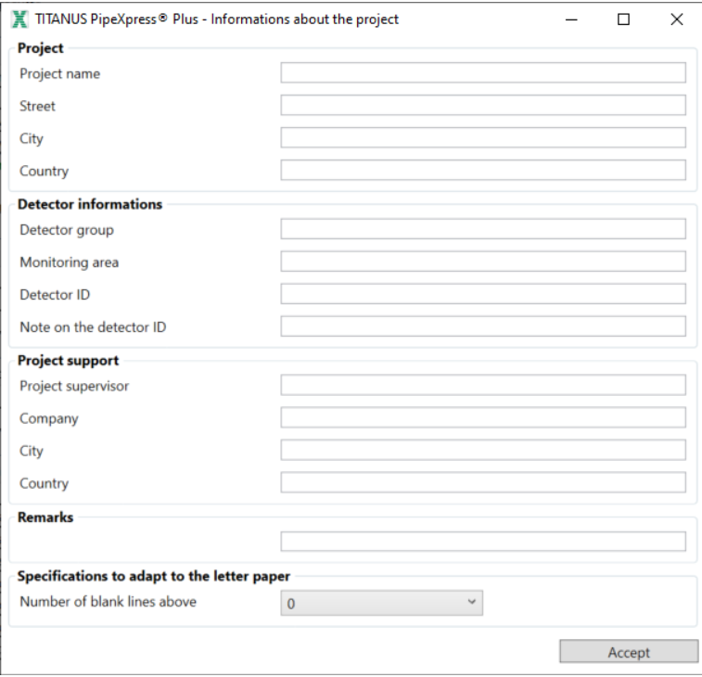
Generating Certificate of Conformity
Producing the certificate of conformity
You have performed a calculation of existing pipe systems or an automatic calculation and the window Calculation results is displayed.
In the window Calculation results the message Calculation results OK.
The results are within the specifications. appears.
Click on the button Create certificate of conformity or Create certificate of conformity with material list.
If the distances between the air sampling points are smaller than or equal to the normative specifications, the window Informations about the project opens.

Slide 30
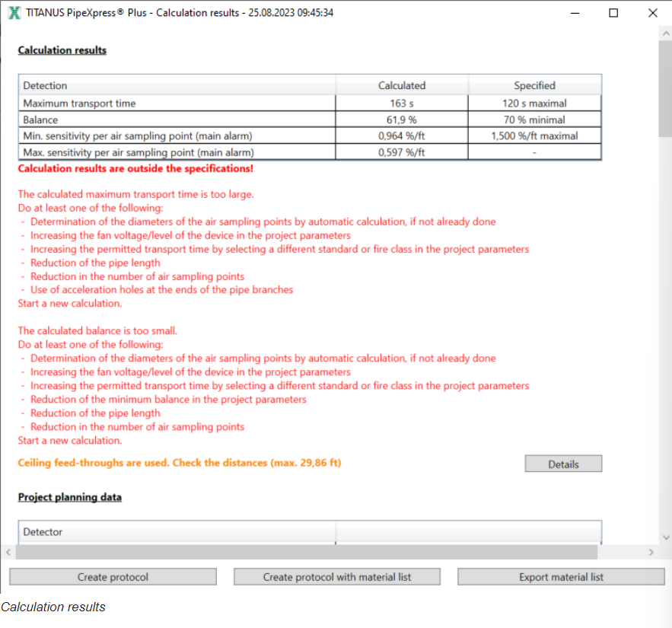
Producing the protocols
Producing the protocols
For your documentation, you can create protocols of the following calculations:
Calculation of the existing pipe systems or automatic calculation if the calculation results are outside of the specifications
Calculation for cleaning the pipe system
Calculation of existing pipe systems or automatic calculation
You have performed a calculation of existing pipe systems or an automatic calculation and the window Calculation results is displayed.
In the window Calculation results the message Calculation results are outside the specifications! appears.

Slide 31
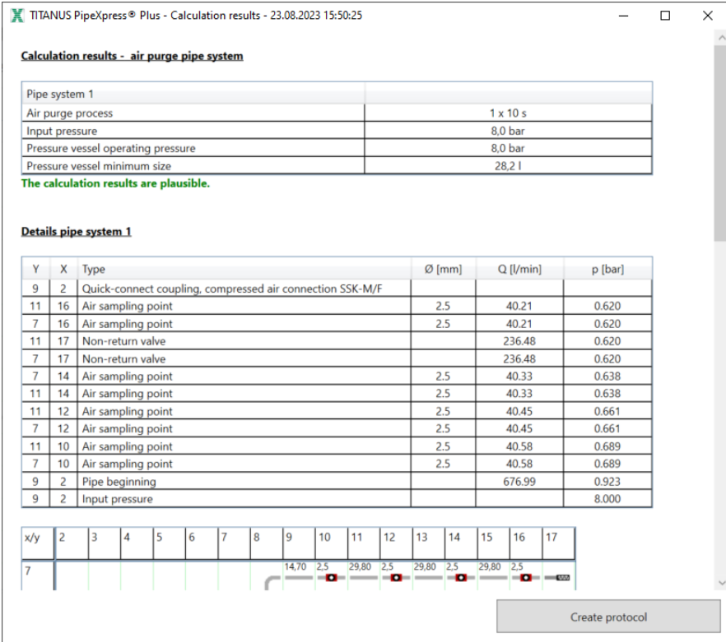
Calculation for cleaning the pipe system
You have performed a calculation for cleaning the pipe system and the window Calculation results is displayed.

Slide 32
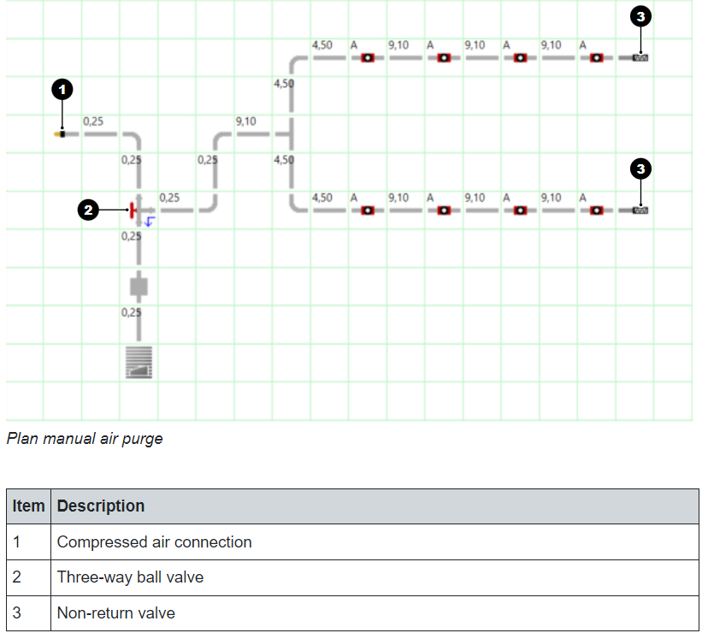
Example project with manual air purge
You can use a manual air purge or an automatic air purge to clean the pipe system and the air sampling points in difficult areas at certain intervals.
In very dusty applications, the deposits forming in the pipe system are purged with overpressure via the non-return valves at the pipe branch ends.
In deep-freeze areas, the air sampling points are de-iced with short bursts of compressed air.
Manual air purge systems are used when purging is to take place occasionally at irregular intervals. The pipe system is purged by manually operating the three-way ball valve.
In projects with manual air purge or automatic air purge, all air sampling points must be planned with clips.
The following illustration shows example project planning with manual air purge.

Slide 33
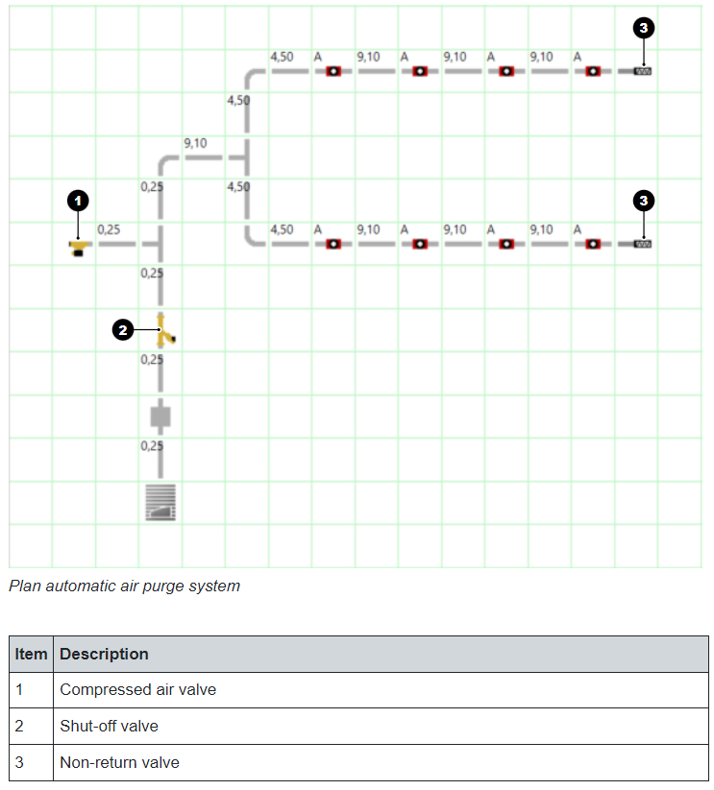
Example project with automatic air purge system
You can use a manual air purge or an automatic air purge to clean the pipe system and the air sampling points in difficult areas at certain intervals.
In very dusty applications, the deposits forming in the pipe system are purged with overpressure via the non-return valves at the pipe branch ends.
In deep-freeze areas, the air sampling points are de-iced with short bursts of compressed air.
Automatic air purge systems are used when purging is to take place relatively frequently at regular intervals. The pipe system is purged with the help of valve control.
In projects with manual air purge or automatic air purge, all air sampling points must be planned with clips.
The following illustration shows example project planning with automatic air purge.

Slide 34
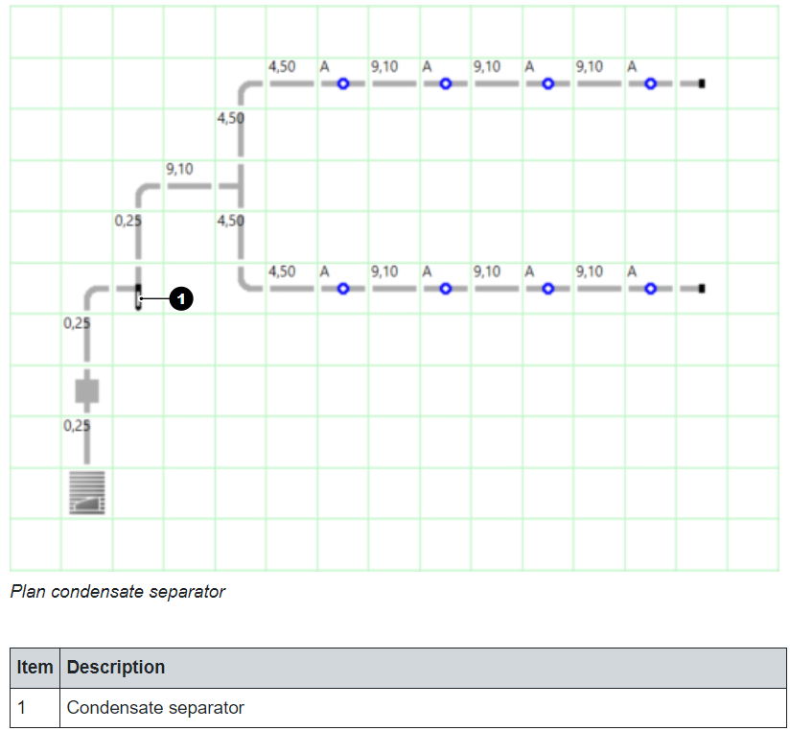
Example project with condensate separator
A condensate separator is used in monitoring areas where condensate can form in the pipe, for instance
in case of heavily fluctuating temperatures (high humidity),
if humid sample air is warmer than the immediate vicinity of the pipe and device,
for fresh air monitoring.
The condensate separator must be planned at the lowest point of the pipe system before the air filter and the air sampling smoke detector.
The following illustration shows example project planning with a condensate separator.

Slide 35
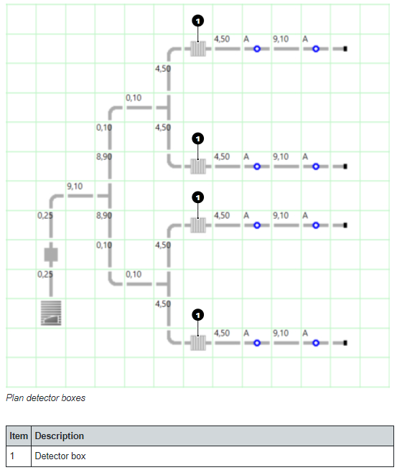
Example project with detector boxes
You can use detector boxes for the following applications:
Setup of a dual detection dependency
Localization of the pipe branch exposed to smoke in multi-branch pipe systems
Increase of the sensitivity of multi-branch pipe systems
The following illustration shows example project planning with detector boxes.

Slide 36
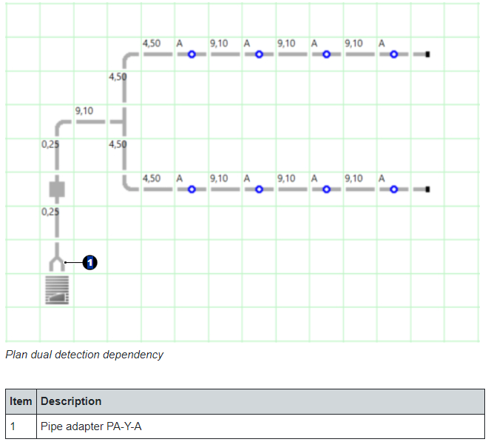
Example project with dual detection dependency
With dual detection dependency, the fire alarm state is only initiated when both detector modules send alarm signals. As soon as the first detector module responds, both an internal alarm and a control function can be initiated.
To project plan a dual detection dependency, you will need two detector modules in the air sampling smoke detector. The pipe system is connected using the pipe adapter PA-Y-A to the air sampling smoke detector.
The following illustration shows example project planning with dual detection dependency.

Slide 37
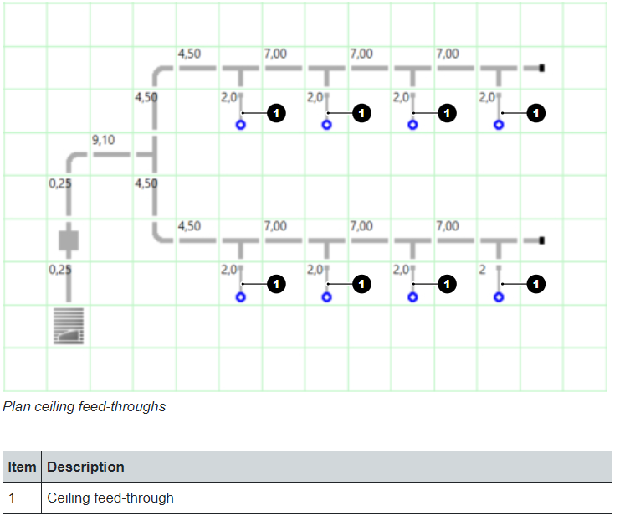
Example project with ceiling feed-through
Ceiling feed-throughs are used when the pipe system is to be installed at a distance from the air sampling points, e.g. to conceal the pipe system in areas with high aesthetic requirements. The air sampling points are fixed in a false ceiling and channeled to the pipe system via hose lines.
The effective distance of the air sampling points is increased by the length of the hose in the case of ceiling feed-throughs.
In projects with ceiling feed-throughs, you must measure the distance of the air sampling points on the actual pipe system. If the distance between the air sampling points is less than or equal to the normative specifications, conformity to the selected standard is fulfilled.
The following illustration shows example project planning with ceiling feed-through.
C

Slide 38
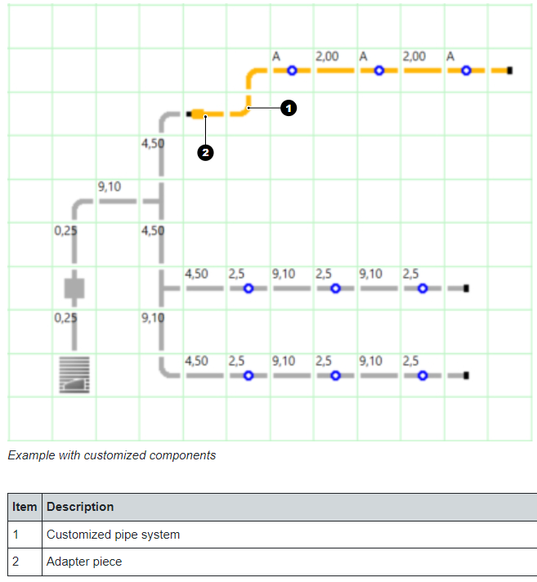
Example project with customized components
You can create customized components to define your own pipe diameters or define your own components based on existing components.
To connect pipe systems with different pipe diameters to each other, you need the adapter for customized components.
The following illustration shows example project planning with customized components.

Slide 39
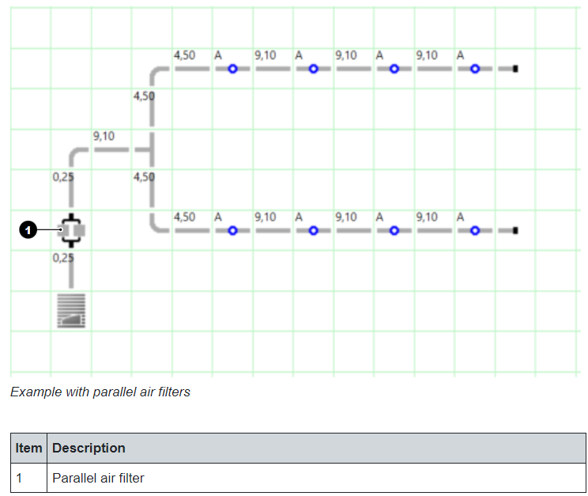
Example project with parallel air filters
To extend maintenance intervals, several air filters can be operated in parallel in the main intake line of the pipe supply. The pipe supply coming from the air sampling smoke detector is divided into two or more branches to which air filters of the same type are connected. The individual pipe supply lines are then brought together again to form a joint pipe supply line.
The following illustration shows example project planning with parallel air filters.

Slide 40
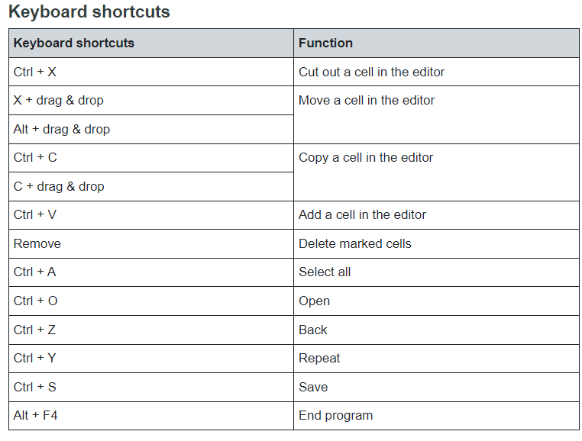
Keyboard shortcuts

Slide 41
Fire Detection Solution Partner for Life
The Solution to exceed your expectations!
Thank you!

