Slide 1

Agenda
General View of ASD
Related Product Listing and Installation Codes.
Principles of Aspirating Smoke Detection
Piping Requirements
Maintenance
Some Application
Slide 1

Slide 2

1. General Overview
1. General Overview

Slide 3



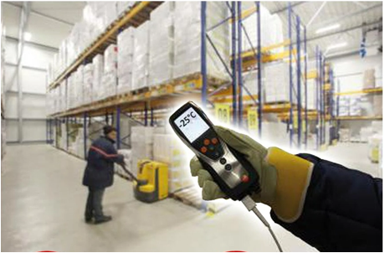
General Application Components
When and Why use ASD in place of Point Detectors
Aspirating smoke detection systems are used to protect spaces in which point, or beam type smoke detectors would present difficulties on the basis of:
Vulnerability to the loss of high value equipment, processes, research and data. This leads to increased demand for faster and more reliable fire detection
Aesthetics
Height of the space
Temperature of the space
Difficult maintenance access
Notes:
Aesthetics (aspirating pipework might be run in floor voids, with capillary tubes sampling air from the space below via a small hole drilled in the ceiling);
Height of the space (the cumulative sampling provided by aspirating smoke detection systems, coupled with the possibility of running pipework vertically on the walls and storage racks, can provide enhanced protection compared with point smoke detectors mounted at ceiling level);
Temperature of the space (e.g. in cold stores, the detector can be located outside the space, so that it is not directly exposed to low temperatures);
Difficult maintenance access (in areas where access for maintenance will be restricted or even impossible after installation, the detector can be located outside the restricted space).

Slide 4
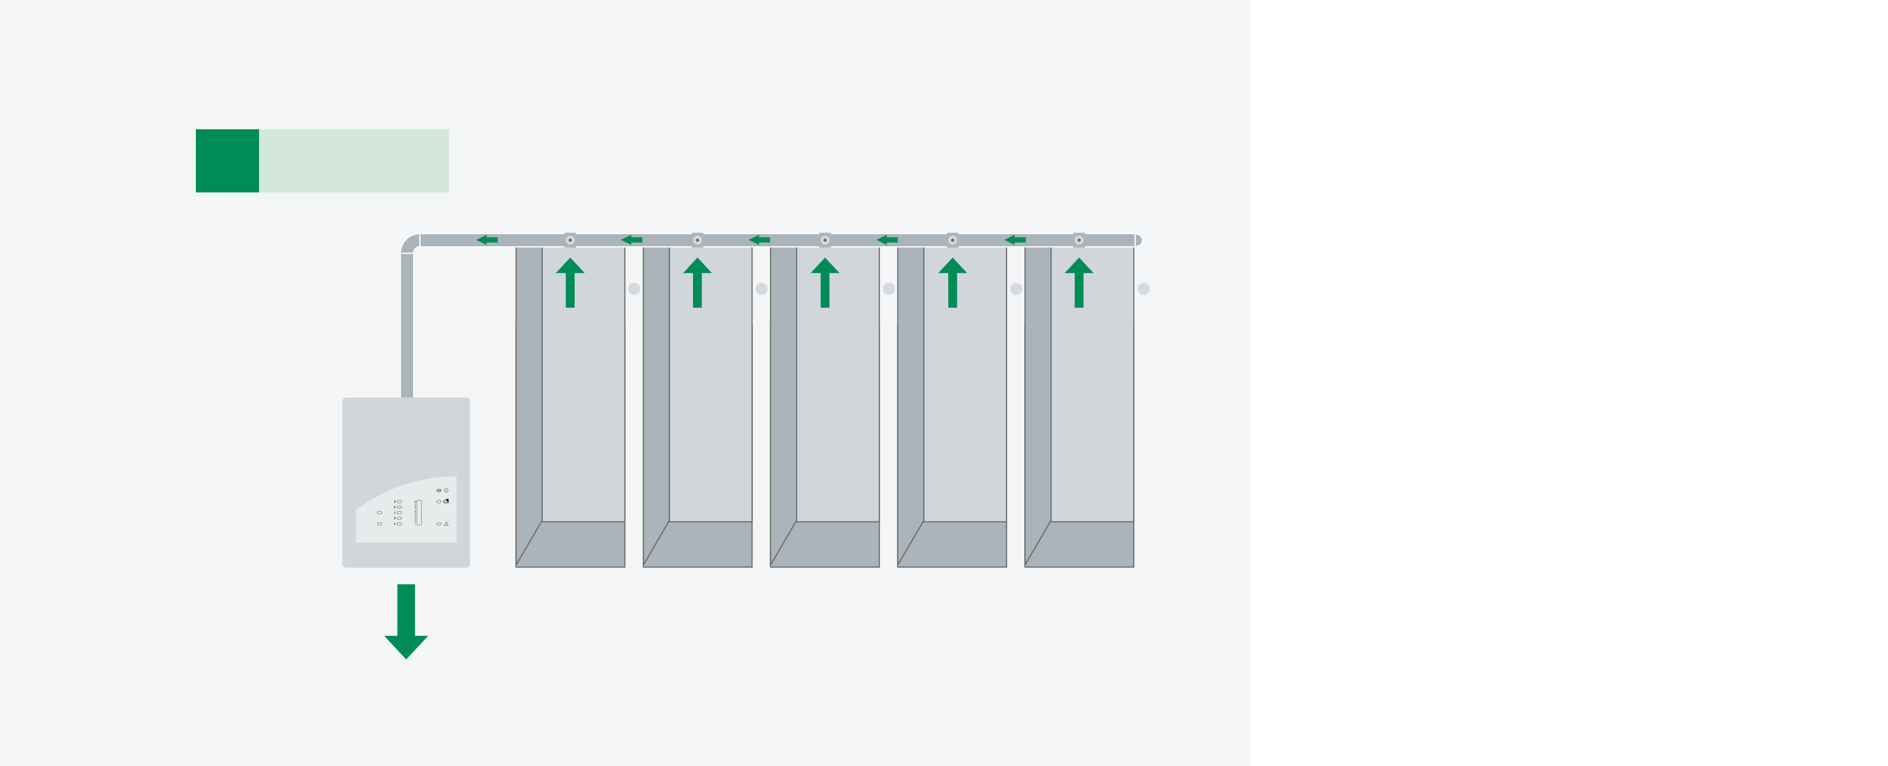
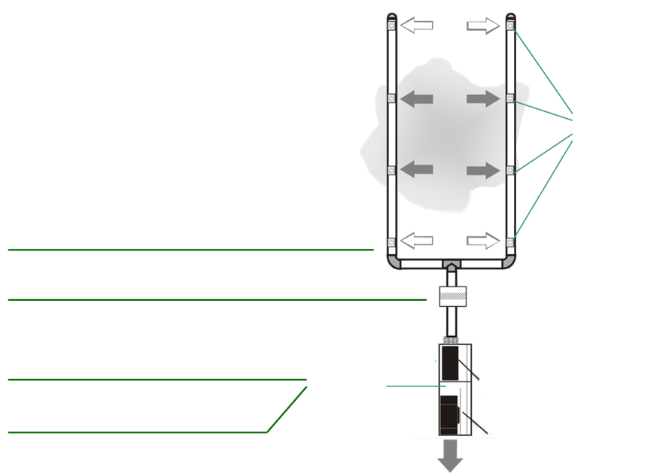
System Components
The basic ASD system has three main components:
The sampling pipe network
An aspirating smoke detector
The exhaust pipe to expel the sampled air from the detector.
collective effect
Sampling Point
air sampling
continuous aspiration of air samples
air filter (optional)
… condensate separator, detonation prevention device, …
airflow sensor
detection
unit
Detector Module(s)
(very early) fire detection
central technology
fan
Exhaust
Notes:
The sampling pipe network, which collects air through sampling holes and transports it from the protected space to the detector, where it’s tested for the presence of smoke particulate
An aspirating smoke detector constituted of:
A sensing chamber with a high sensitivity sensor to detect smoke particles suspended in air
An aspirator or fan to draw air from the protected area to the sensing chamber
An optional filter to remove all large particles that may damage the sensor within the sensing chamber
The exhaust pipe to expel the sampled air from the detector.

Slide 5
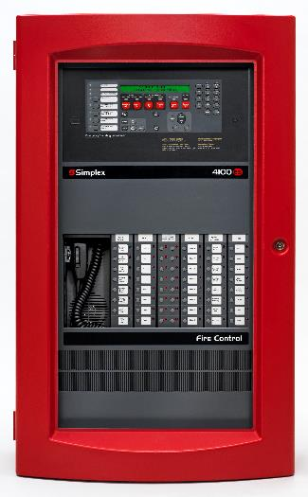
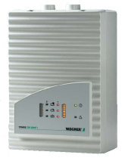
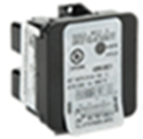
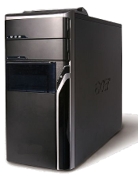
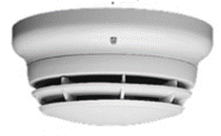
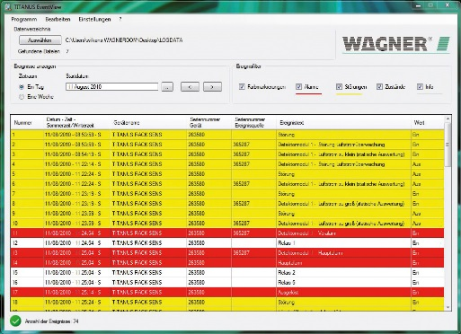
INTERFACE
24V DC Power Supply
(Depends on Listing Requirements)
** Not advisable to tap from Fire Panel Auxillary supply du to high Standby Current.
Similar practice to all other ASD Market offering
Optional Independent Monitoring thru Desktop thru RJ45 connection to Optional RJ45 connection on ASD.
** Similar practice to all other ASD Market offering
Alarm
Input
Modules
TCP/IP
(Requires Router to extend 100m distance Limit)
Fault
4100ES FACP
Addressable Loop
ASD
(Depends on Model for Application)

Slide 6
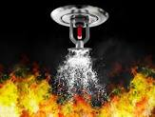
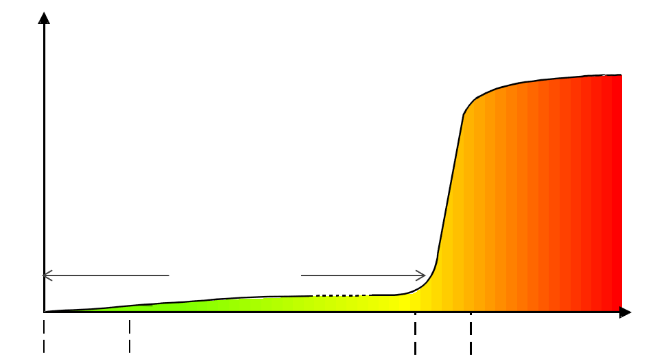
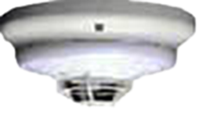
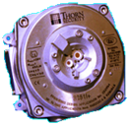
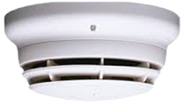



Fire Intensity Graph – Solid Material
sprinkler systems
heat detectors
flame detectors
point-type smoke detectors (general)
aspirating smoke detectors
(depending on sensitivity)
fire gas detectors:
no general statement
possible due to the
wide range
up to hours
ignition /
pyrolysis
smoldering fire
devel.
fire
fully developed
fire
t

Slide 7
2. Related Listing and Installation Code for Aspirating Smoke Detection

Slide 8
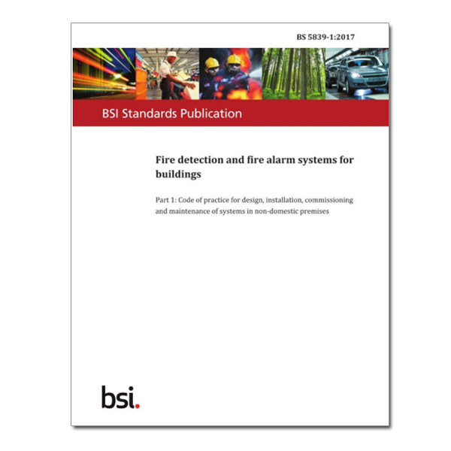

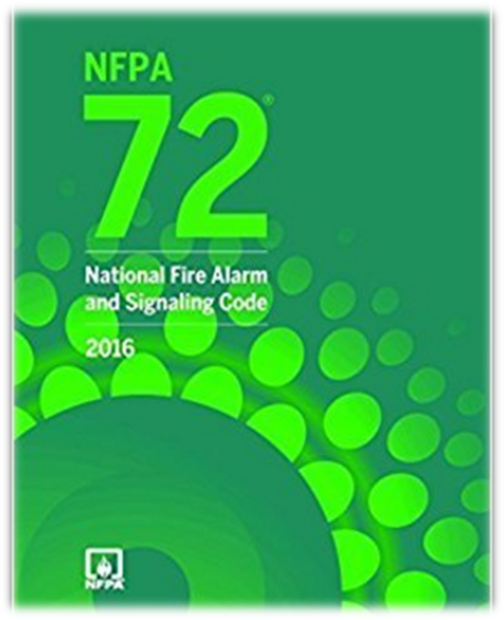
Product Listing and Installation Codes
In Europe:
Fire Detection and Fire Alarm Systems – Part 20: Aspirating Smoke Detectors (EN54-20) for Product Performance, it is also the standard for the installation of ASD systems in Europe.
In Europe, for each specific installation the local standards and codes of practice should be adhered to. Guidance on the design of systems is given in BS 5839, BS6266 and/or FIA Code of Practice for the Design, Installation, Commissioning and Maintenance of Aspirating Smoke Detector (ASD) Systems
In the United States:
Aspirating Smoke Detectors for US falls under UL268 7th Edition for Product Performance as it is a smoke related devices.
National Fire Alarm and Signaling Code (NFPA 72)
Standard for the protection of information Technology Equipment (NFPA 75)
Standard for the Fire Protection of Telecommunications Facilities (NFPA 76)
  ** Both NFPA75 and 76 besides installation relating to product performance.

Slide 9
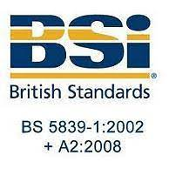




What is the difference between BS5849 Standards, Product Listing and Building Codes?
Europeon Standards: Design, Installation , Acceptance and Servicing Guide for Owner, Consultants…etc
BS5849 & BS6266
IEC
Country Standards
Design, Installation, Acceptance and Servicing Guide for Building.
=
+
+
How?
As per Individual Country
Product Performance and function to be able to comply to Europeon Requirements for Fire Detection Equipments.
Europeon Listing: Product Performance demanded by Insurance companies
What?
=
+
**Note: Typically when you used BS5839 Installation standards the right Laboratories certifications to match seamlessly would be EN54, LPCB or VDS Listing.
When & Where : Local Building Codes Requirements
Local or Global Building Codes Applications Where Required.
=
When?
+
Local Country Codes /Local Practise
Online Continuous Learning Series
Notes:
EN 54 Standard
The EN 54 Fire detection and fire alarm systems is a mandatory standard that specifies requirements and laboratory test for every component of fire detection and fire alarm system and it allows the free movement of construction products between countries of the European Union market.
It was developed and approved by European Committee for Standardization (CEN, French: Comité Européen de Normalisation).
This standard is widely recognized around the world for several countries outside of European Union. It is recognized in Middle East, Latin American countries, Brazil, African and Asian countries and several islands in the Pacific Ocean.

Slide 10



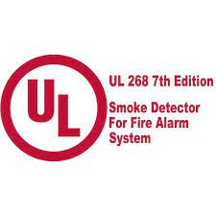



What is the difference between NFPA Standards, Product Listing and Building Codes?
NFPA Standards: Design, Installation , Acceptance and Servicing Guide for Owner, Consultants…etc
NFPA101
NFPA75
NFPA76
NFPA72
Design, Installation, Acceptance and Servicing Guide for Building.
=
+
+
+
How?
Product Performance and function to be able to comply to NFPA Requirements for Fire Detection Equipments.
UL & FM Listing: Product Performance demanded by Insurance companies
What?
=
+
+
+
**Note: Typically when you used NFPA72 standards the right Laboratories certifications to match seamlessly would be UL and FM Listing. However in this case for Data Centre Product performance are also included in NFPA75/76
When & Where : Local Building Codes Requirements
Local or Global Building Codes Applications Where Required.
=
When?
+
+
Local Country Codes /Local Practise
Online Continuous Learning Series
Notes:
NFPA101 is the application guide, with vertical ready solutions, for example data centres, hotels, factories…etc to combine all the required codes, from fire detection(NFPA72), sprinkler design(NFPA13) …etc.
This will be complimented with UL Listing and FM Listing which provides product performance, to match to NFPA72 requirements.
These are important milestone considerations, for insurance companies on building coverage.

Slide 11
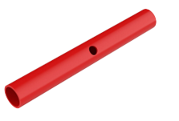
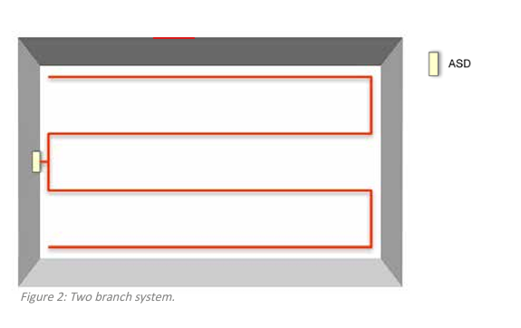
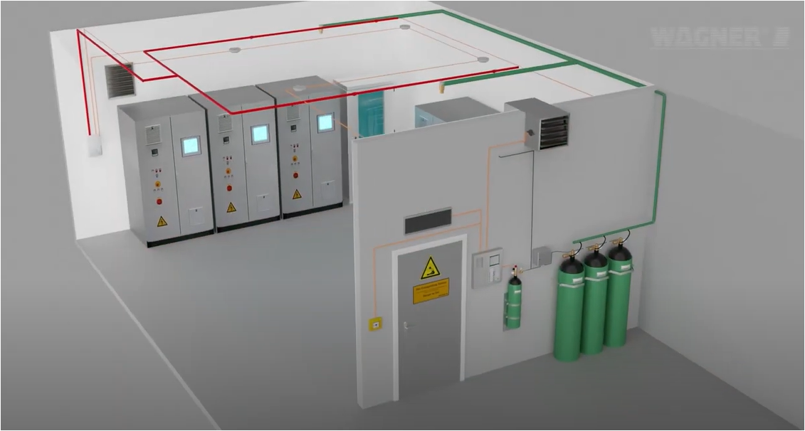
5 Key Definitions relating to Aspiration Smoke Detector
(This is important to include in the Spec to avoid being spec out by Other brands)
Air Drawn thru Sampling Hole
A. Sampling Hole: Hole in a piping network that draws air by an aspiration device to an ASD.
B. Transport Time: The time it takes for a particle from the last air sampling point to reach the detection chamber of the detector.
C. Response Time: Time Between the Smoke Particles to travel from the Sampling Point to the ASD.
D. Maximum Transport Time: Maximum allowable time to transport smoke particles from the sampling hole to response at the ASD; measured at the most remote or least sensitive sampling hole.
E. Sampling Piping Network: Vehicle in which the sampled air is transported from the protected area to the detector.
End
Start

Slide 12
Similarities the European and United States on installation and monitoring requirements
There are many similarities between the European and United States installation and monitoring requirements. The definitions for the components are the same in both EN 54-20 and NFPA75 AND 76 requirements
A fault signal shall be initiated when the airflow is outside the operational (manufacturer’s) specified range.
The airflow through the ASD and sampling pipe shall be monitored to detect a leak or obstruction in a sampling hole.
The sampling pipes and fittings` shall have mechanical strength and be listed for the temperatures and environmental conditions where they are being installed.

Slide 13
Classification Guide Base on EN54-20 or NFPA?
Both Europeon and US Guide have similar end objective however the approach and definition are different.
EN 54-20 is performance-based and requires ASD systems to pass a series of Test Fires (TF) to validate the classification of a Class A, Class B, or Class C system.
Class A – Very High Sensitivity
Computer Rooms
Clean Rooms
Telecommunications
Process Control Machinery
Bio-Medical Facilities
Class B – Enhanced Sensitivity
Shopping Atria
Warehouses
Cold Store
Aircraft Hangars
Sports Stadia
Class C – Normal Sensitivity
An alternative to point or beam type smoke detectors
Ceiling Voids
EMC Areas
Floor Voids
High Ceilings
NFPA requirement for ASD are prescriptive in nature and provide specific sampling hole spacing distances and ASD unit sensitivities for each type of system (SFD, EWFD, and VEWFD).
Abbr | Details of Systems
SFD | Standard Fire Detection
EWFD | Early Warning Fire Detection
VEWFD | Very Early Warning Fire Detection

Slide 14
EN54-20 Classification table for aspirating smoke detectors
(Europeon Standards)
Class | Description | Example application(s) | Requirement
A | Aspirating smoke detector Providing very high Sensitivity | Very early detection: the detection of very dilute smoke that could emanate from equipment in an environmentally controlled area and enter air conditioning ducts | Passes test fires TF2A, TF3A, TF4 and TF5A.
B | Aspirating smoke Detector providing Enhance Sensitivity | Early detection: for example, special fire detection within or close to particularly valuable, vulnerable, or critical items such as computer or electronic equipment cabinets. | Passes test fires TF2B, TF3B, TF4 and TF5B.
C | Aspirating smoke Detector providing Normal Sensitivity | Standard detection: general fire detection in normal rooms or spaces, giving for example, at least an equivalent level of detection as a point or beam type smoke detection system. | Passes test fires TF2, TF3, TF4 and TF5.
Type of Materials Relating to TFX Test(X is the number)
Smouldering (pyrolysis) wood fire (TF2), Glowing smouldering cotton fire (TF3), Flaming plastics (polyurethane) fire (TF4), Flaming liquid (n-heptane) fire (TF5)
“A” means the worst case configuration for the Class A testing;
“B” means the worst case configuration for the Class B testing;
“C” means the worst case configuration for the Class C testing;(Without any Alphabet)

Slide 15
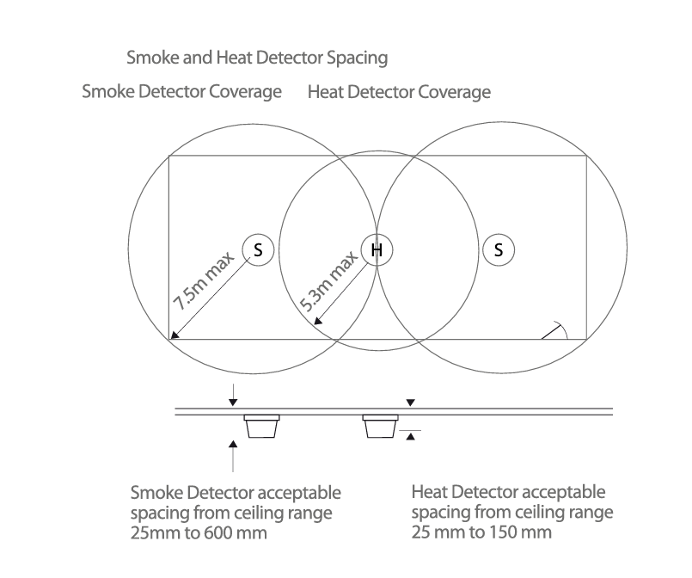
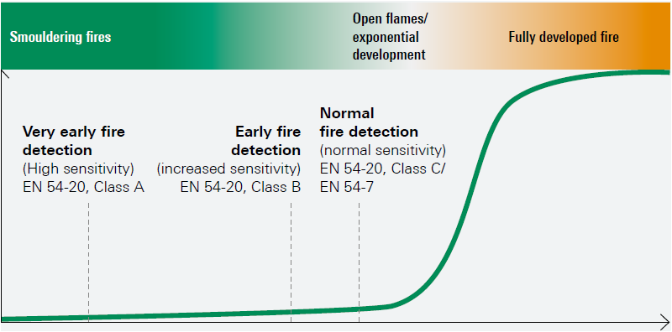
Flat Ceiling Spacing - BS 5839-1:2017 (Europeon Standards)
Where an aspirating smoke detection system is intended to provide general area protection, each aspirating sampling point should be regarded as a point smoke detector, provided that a single sampling point has equivalent sensitivity to a point type smoke detector.
Notes:
Smoke detection devices have an individual coverage of 7.5m radius. However, these radii must overlap to ensure there are no ‘blind spots’. Therefore the individual coverage can be represented by a square measuring 10.6 x 10.6m giving an actual area coverage of 112m² per device.

Slide 16
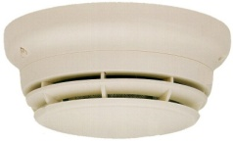
Flat Ceiling Spacing – NFP72 Chapter 17(American Standards)
30 feet(9.1 m)
17.7.3.6 Air Sampling–Type Smoke Detector
17.7.3.6.1.1* In the absence of specific performance-based design criteria, each sampling port of an air sampling–type smoke detector shall be treated as a spot-type smoke detector for the purpose of location and spacing in accordance with 17.7.3.
21 feet(6.3m)
30 feet(9.1 m)
ACTUAL COVERAGE AREA

Slide 17
United States Definitions and Requirements (American Standards)
Within the USA, NFPA 76 “Fire Protection of Telecommunication Facilities” provides the following definitions:
Very Early Warning Fire Detection (VEWFD) Systems: Systems that detect low-energy fires, before the fire conditions threaten telecommunications service.
Early Warning Fire Detection (EWFD) System: Systems that use smoke, heat, or flame detectors to detect fires before high heat conditions threaten human life or cause significant damage to telecommunications service.
Standard Fire Detection (SFD) System: Systems that use fire detection-initiating devices to achieve certain life safety and property protection, in accordance with applicable standards.

Slide 18
Requirements of SFD(Standard Fire Detection) systems according to NFPA 72
(American Standards)
The requirements for the ASD System are outlined in the Initiating Devices Section of NFPA 72 and require that each sampling hole be the equivalent to a spot-type smoke detector for the purpose of location and spacing.
A traditional spot-type smoke detection system is spaced at 30 ft. (9.1 m). on centers, or each detector could protect 900 ft.. ² (83.6 m²).
Therefore, the ASD sampling holes would be spaced in the same configuration.
The maximum transport time for a SFD system, from the most remote sampling hole to the ASD, cannot exceed 120 seconds
The transport times and system performance are required to be calculated by design software and confirmed during the commissioning process
The ASD unit shall provide a trouble signal if the airflow is outside the manufacturer’s specified range

Slide 19
Requirements of Early Warning Fire Detection (EWFD) System systems according to NFPA 76 (American Standards)
When standard fire protection and detector spacing won’t suffice, NFPA 72 outlines the requirements for more sensitive smoke detection systems that provide early warning to the presence of smoke.
The code classifies two levels of smoke detection systems:
  Early Warning Fire Detection (EWFD) and
  Very Early Warning Fire Detection (VEWFD).
The following are installation requirements for EWFD ASD systems, as outlined in NFPA 76:
  The coverage area for a single sampling hole is limited to 400 ft..² (37.2 m²).
  The minimum alarm sensitivity for a single sampling hole is required to be a maximum of 1.5% obs/ft..
  The maximum transport time is 90 seconds.

Slide 20
Requirements of Very Early Warning Fire Detection (VEWFD) Systems according to NFPA 76
(American Standards)
When more sensitive detection is necessary, NFPA 72 outlines the installation requirements of these systems.
The following are requirements for VEWFD ASD systems, as outlined in NFPA 76.
  The coverage area for a single sampling hole is limited to 200 ft..² (18.6 m²)
  The minimum alert sensitivities for a single sampling hole is required to be a maximum of 0.2% obs/ft..
  The minimum alarm sensitivity for a single sampling hole is required to be a maximum of 1.0% obs/ft..
  The maximum transport time is 60 seconds
Where two levels of detection is required, high and low, sampling holes are required in the following locations:
  Each level of protection is required to have a maximum of 400 ft..² (37.2 m²) per sampling hole.
  The overall coverage between high and low sampling holes is required to be a maximum of 200 ft..² (18.6 m²).
  The maximum transport time is 60 seconds.

Slide 21
NFPA 75 and 76 Code Requirement Matrix (American Standards)
NFPA (72 and 76) Requirement
System | Alert Sensitivity (at each sampling hole) | Alarm Sensitivity (at each Sampling hole) | Sampling Point Coverage Area | Transport Time
VEWFD | 0.2% obs/ft.. | 1.0% obs/ft.. | 200 ft.. ² (18.6 m ²) | <60 secs..
EWFD | N/A | 1.5% obs/ft.. | 400 ft..² (37.2 m²) | <90 secs..
SFD | N/A | No greater than spot smoke detector | 900 ft..² (83.6 m²) | <120 secs..
**Note: As per the above codes guidelines it indicate very clearly there is no requirement to have sensitivity or transport time of ASD beyond the specification as above. Providing beyond does not offer any major advantage of Operation for end user or any earlier detection which for DataCenter Operation is not preferred.

Slide 22
Principles of Aspirating Smoke Detection

Slide 23
Active aspiration
Point-type smoke detectors
  smoke must enter the measuring chamber
  by convection
  not sufficient that the smoke reaches the detector
Aspirating smoke detectors smoke
  is actively aspirated
Particularly problematic:
  Heat stratification under the room ceiling make it difficult / prevent the smoke from reaching the point-type smoke detector

Slide 24

General Advantages of ASD
Central technology
Point-type smoke detectors technological effort must be expended in each individual detector
Aspirating smoke detectors
  high technological effort possible at a central location (e.g. fire pattern recognition, high sensitivity)
  additional, significant advantage:
  collective effect (also “cumulative effect”)
  multiplication of smoke sensitivity of each
  impinged sampling point
  different with dust, reason: limited dispersion
  of the larger, heavier dust particles

Slide 25
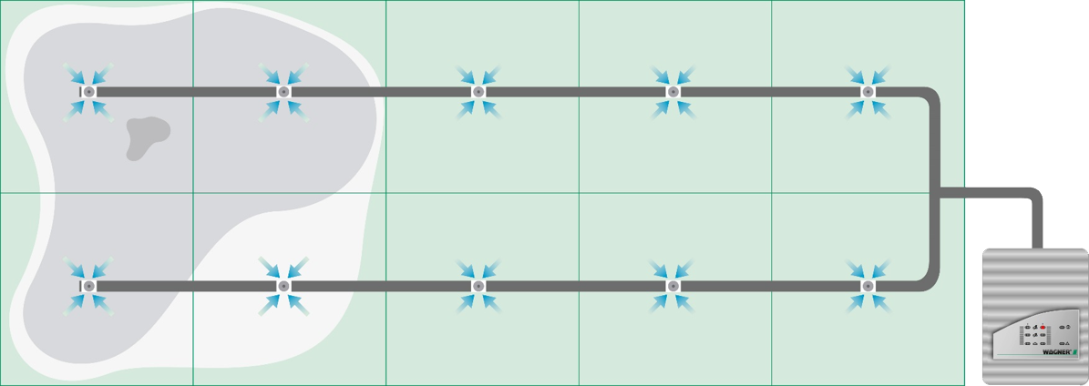

Collective Effect
Predefined alarm sensitivity per
sampling point :
4.0% obs./m
4.0%/m
4.0%/m
4.0%/m
4.0%/m
4.0%/m
1.3%/m
1,3 %/m
4.0%/m
4.0%/m
4.0%/m
4.0%/m
4.0%/m
0.4% obs./m
1.3%/m
0.7%/m
Example:
Each sampling point has an alarm
sensitivity of 4.0% obs./m.
The smoke density does not reach the
alarm sensitivity at any sampling point.
Due to the collective effect, the smoke density of all sampling points is added together.
The resulting light obscuration is sufficient to trigger the alarm:
3 x 1.3% obs./m + 1 x 0.70% obs./m = 4.6% obs./m => alarm

Slide 26
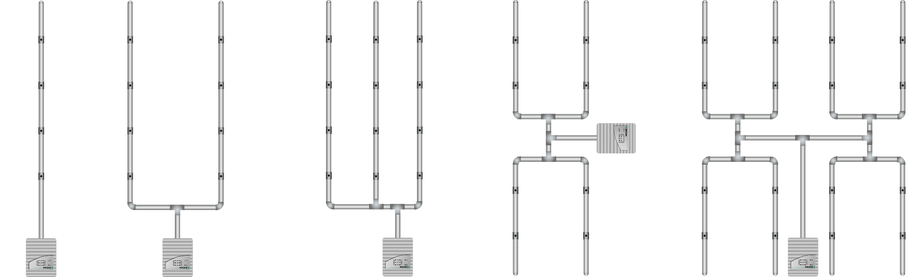
Sampling Pipe Network
I-shaped pipe system
U-shaped pipe system
M-shaped pipe system
double U-shaped pipe system

Slide 27
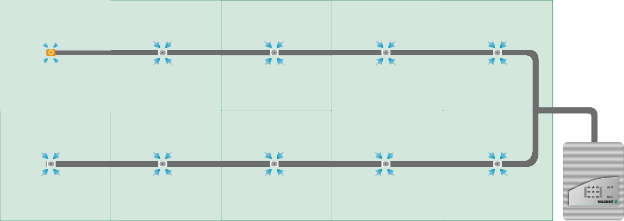
Sensitivity at the Sampling Point
0.35% obs./m
  Example:
  10 sampling points, each with a
  sensitivity of 3.5% obs./m
Detector sensitivity must be 10 x higher than the sensitivity of one sampling point. Reason: Air dilution due to fresh air sampling of the other 9 sampling points
  3.5% obs./m : 10 = 0.35% obs./m

Slide 28
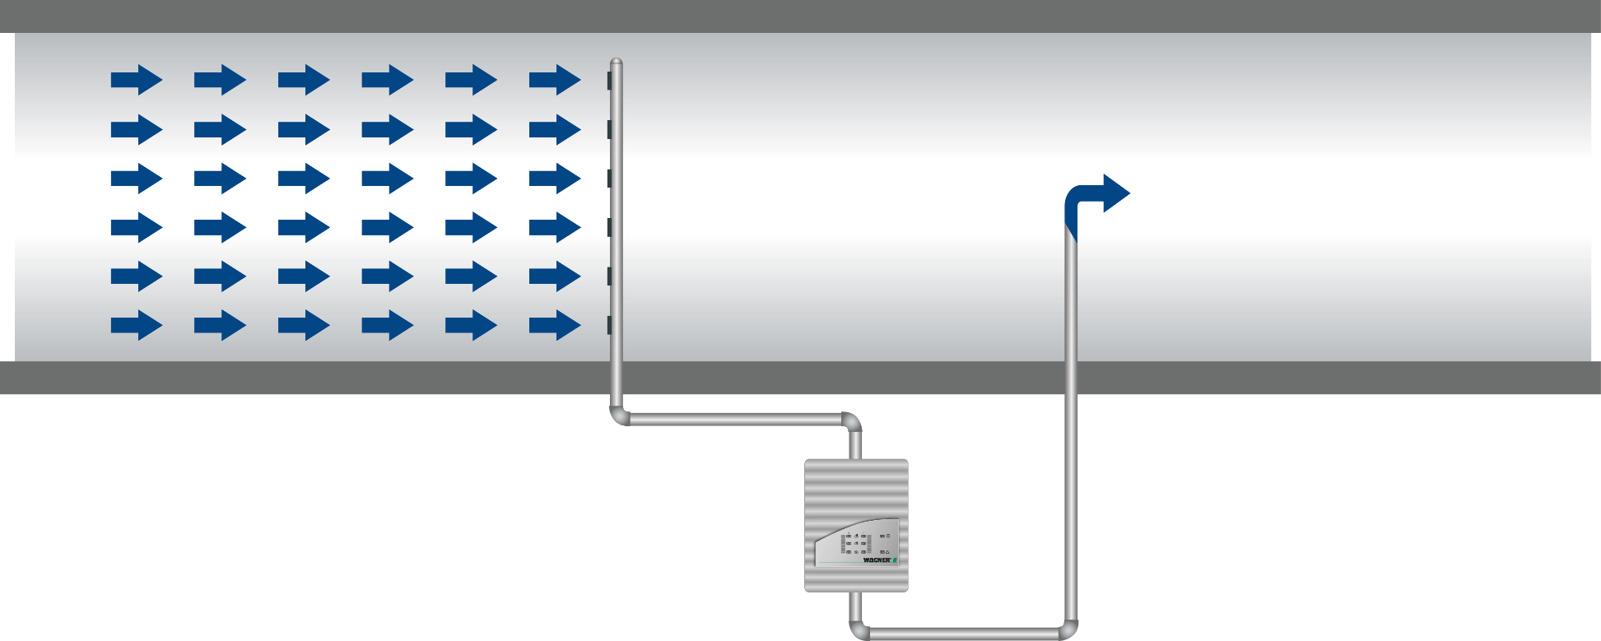
ASD Exhaust Pipe Principles
In normal applications, it is common for the air pressure in the Air Pressure Protected Space (APS) to be the same as the air pressure in the space where the ASD is mounted, and the exhaust pipe is run out of the detector Air Pressure Exhaust Space (AES).
As a result, the design software that calculates transport times and detector sensitivities assumes the air pressures of the two spaces are equal.

Slide 29
Piping Requirements

Slide 30
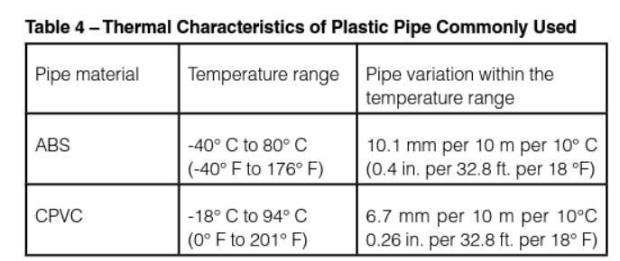
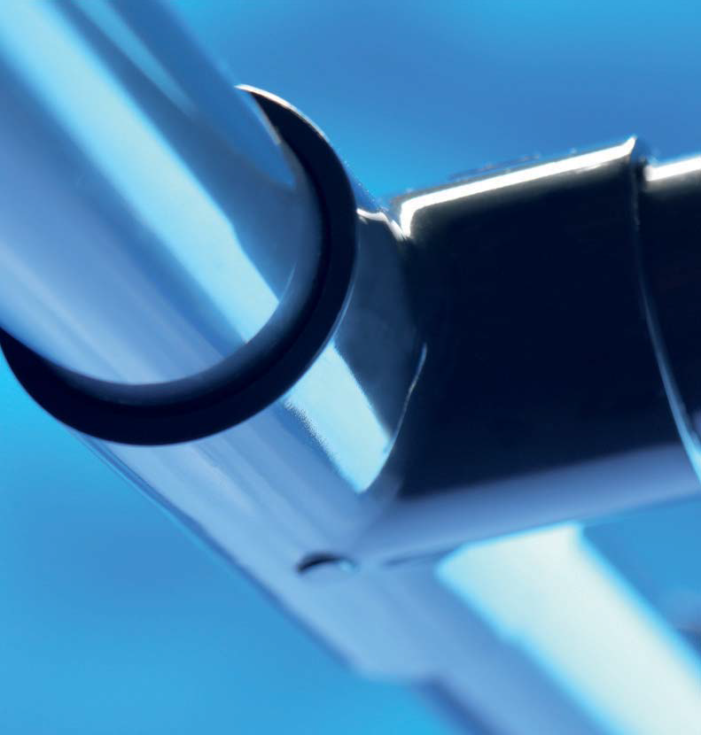
Pipe Requirement
Material: PVC or ABS
For EN54-20 compliance, the pipe should be
Red or grey ABS to EN 61386
with a nominal outside diameter of 25 mm (US: ¾ inch = 19.05 mm)
The pipe sections should be glued together using a suitable ABS glue to avoid separation or leaks. If a section of pipe is likely to need to be disconnected for some reason in the future, removable unions should be used instead.

Slide 31

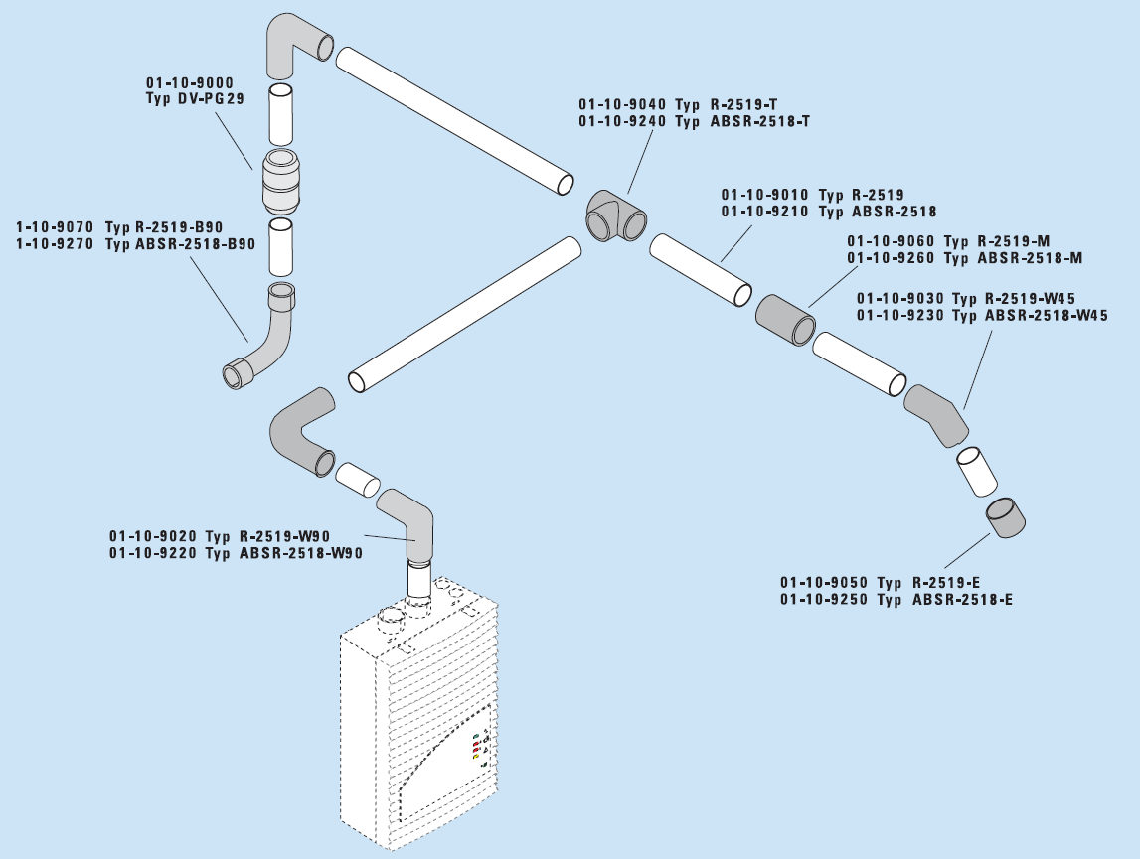
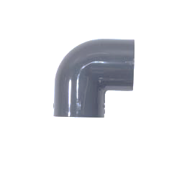
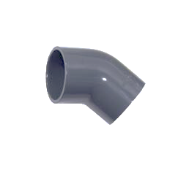
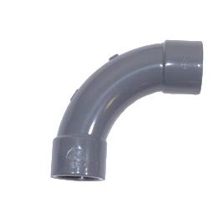
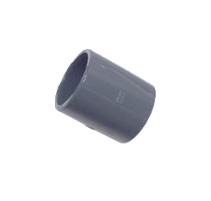
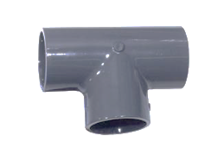
Pipe Requirement
  Pipe fittings
  90°bench 90°elbow 45° elbow
  Joint for pipe connection
  T-pieces for splitting 1 pipe into 2 branches
  End cap for the end of each branch
Not recommended due to high flow resistance

Slide 32
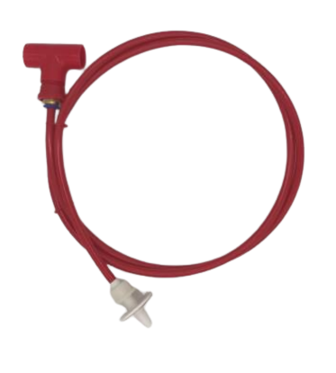
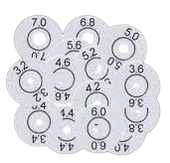

Pipe Label
NFPA 72, FIA, and other recognized codes and standards require ASD pipes be labelled to distinguish them from other pipes and to specifically identify them as a fire detection system component. Both the sampling pipe network and each individual sample hole need to be identified. The pipe and sampling holes should be labelled at the following locations:
At changes in direction or branches of piping
At each side of penetrations of walls, floors, or other barriers
At intervals on piping that provide visibility within the space, but no greater than 61 m (20 ft.)
At each sampling hole.

Slide 33
Maintenance

Slide 34
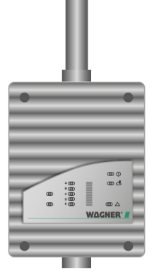

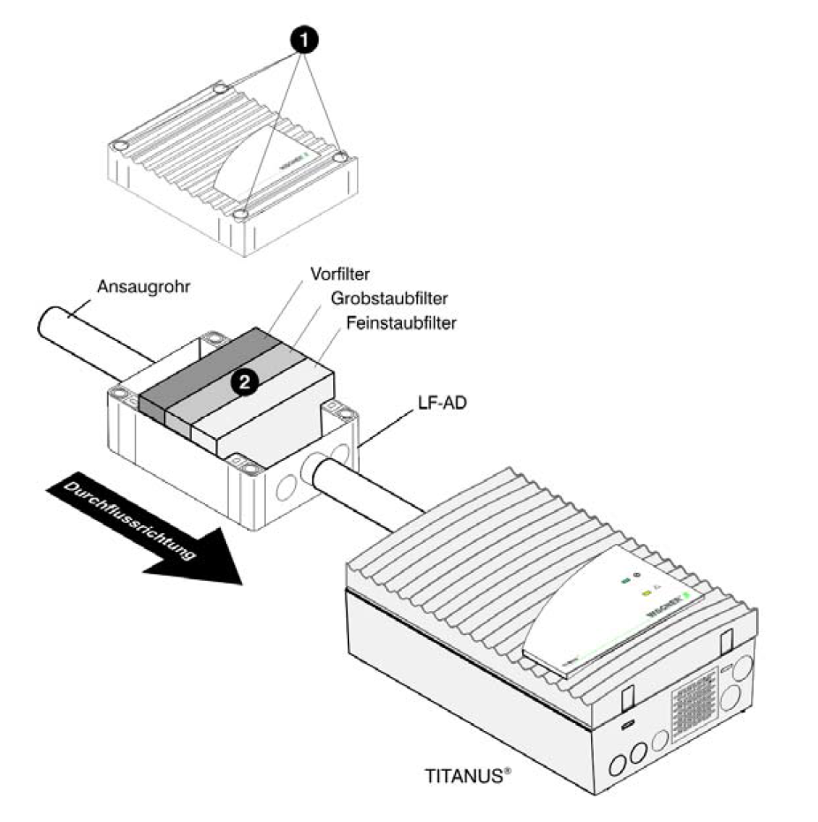
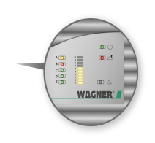
Maintenance
Visual Inspection
Pipe system Check
  In areas with icing or heavy dust accumulation
Detector module
  Trigger the detector module with a smoke pen or suitable test aerosol
Airflow calibration
  Check filter level
Transport time measurement
Reporting
When sampling pipe is installed in a high ceiling or concealed in a sub-floor, a test sampling point can be installed at floor level to make annual testing of the system easier and reduce annual maintenance costs.

Slide 35
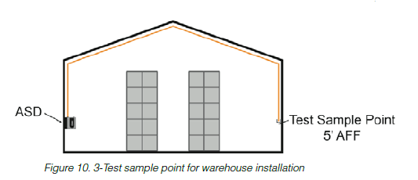
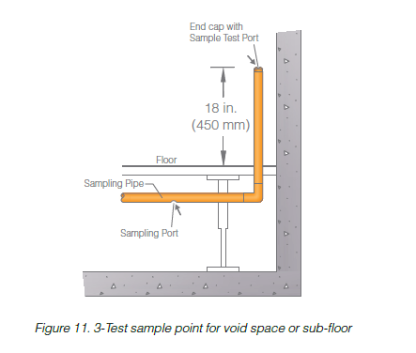
Test Sample Point
Typically, the sampling holes furthest from the ASD detector are tested. If the transport times remain close to the initial results, the system is operating as designed and no further testing is required
If there is a difference of 5-10% between the transport times predicted by the design software and the tested transport times, then the piping network, hole sizes, or the detector settings should be checked to determine the causes of this difference.

Slide 36
Application

Slide 37
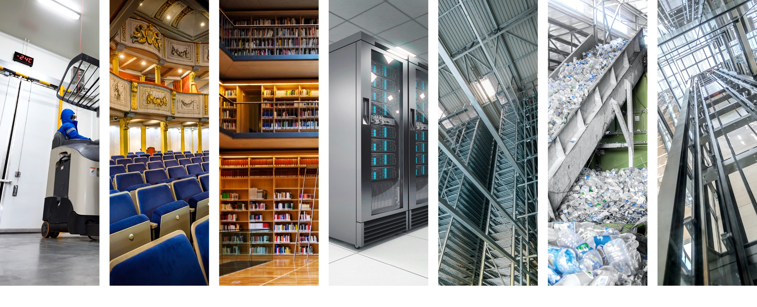
Application Solutions
Deep freeze areas
Aesthetic areas
Noise-sensitive areas
IT areas
High-bay warehouse
Dusty/dirty environment
Elevator shafts

Slide 38
Sampling Types/Methods
Primary sampling
This is essential in applications of high sensitivity and is an arrangement of sample pipes in the direct line of airpath as the low levels of smoke created at the pre-combustion stage of a fire will travel with the airflow. Primary sampling location would be
Air Return Grilles of Air Handling Units
Return duct
Extraction Fans
Pipe cross-section:
sampling point at 30 angle to the airflow

Slide 39
Sampling Types/Methods
Secondary sampling
This is the spacing of sample holes in place of point-type detectors on the ceiling. Sampling method used in conjunction with Primary Sampling.
Localized Sampling
Method involving the protection of specific equipment / area within a larger open space. Localised sampling may be a rack sampling system in a large open warehouse or monitoring the exhaust of a row of computer cabinets

Slide 40
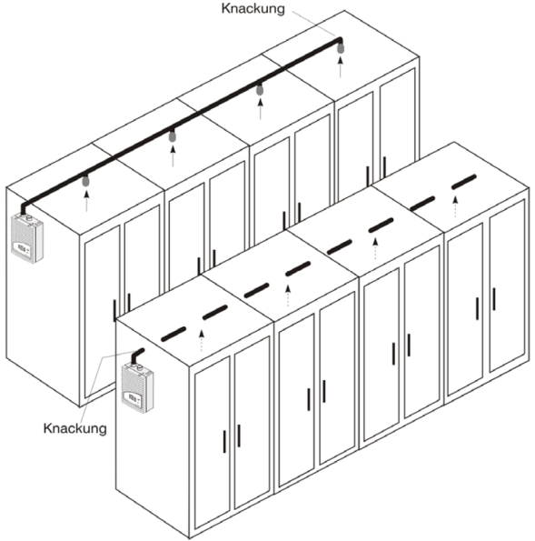
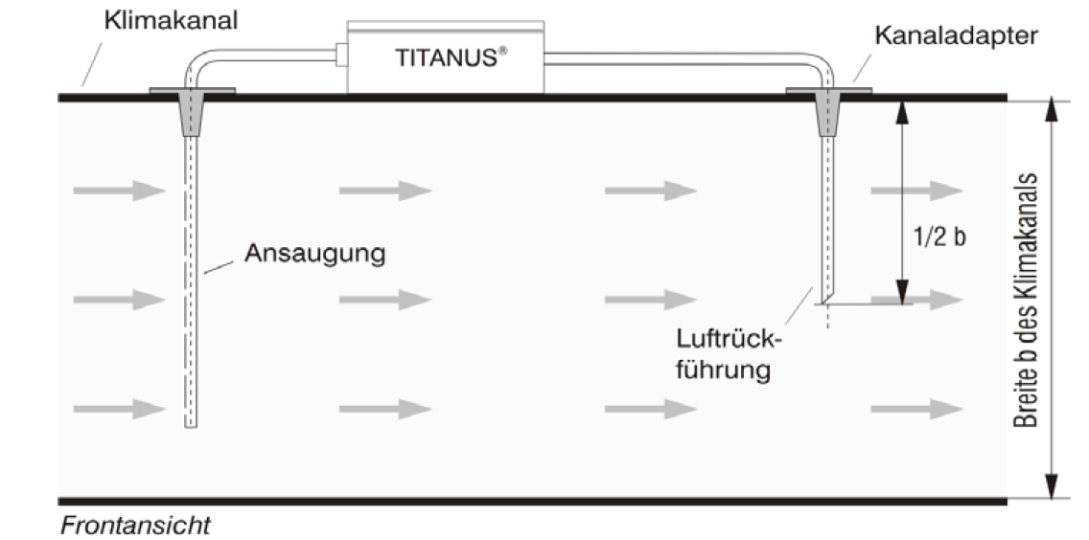
Sampling Types/Methods
In Cabinet Detection
This type of application is very effective, as only a small flexible capillary tube need enter the cabinet, thus making installation simple and avoiding future maintenance restrictions.
Duct Detection
Extensive testing of this type of detection method has resulted in a design approach that will overcome pressure changes as a result of airflow changes in the duct.

Slide 41
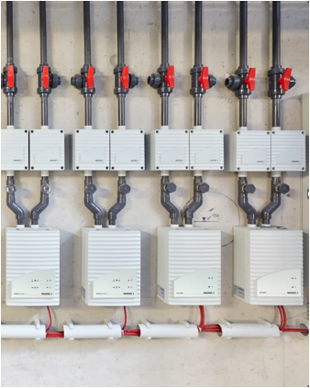
Areas with high dust levels
Early fire detection despite high background concentrations
Sensitive smoke detection by filtering out the larger dust particles
Adjustment of the base level using drift compensation
Suppression of deceptive phenomena by means of fire pattern detection and alarm delay
Adaptation of the solution to
  Particle sizes (graduated filter technologies) and
  accumulating dust quantities (parallel connection of filters or upstream
  connection of an LF-AD before an SF-650)

Slide 42
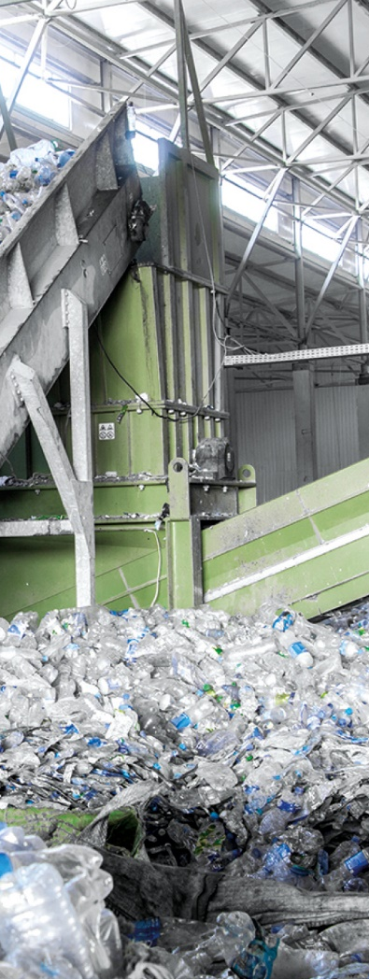
Pipe Surging
Blowing off dust and dirt
Options:
Prophylactic cleaning of the pipe
system – no risk of blockages
Pipe purging when necessary
non-return valve
3-way ball valve
compressed air
(long impulse)

Slide 43
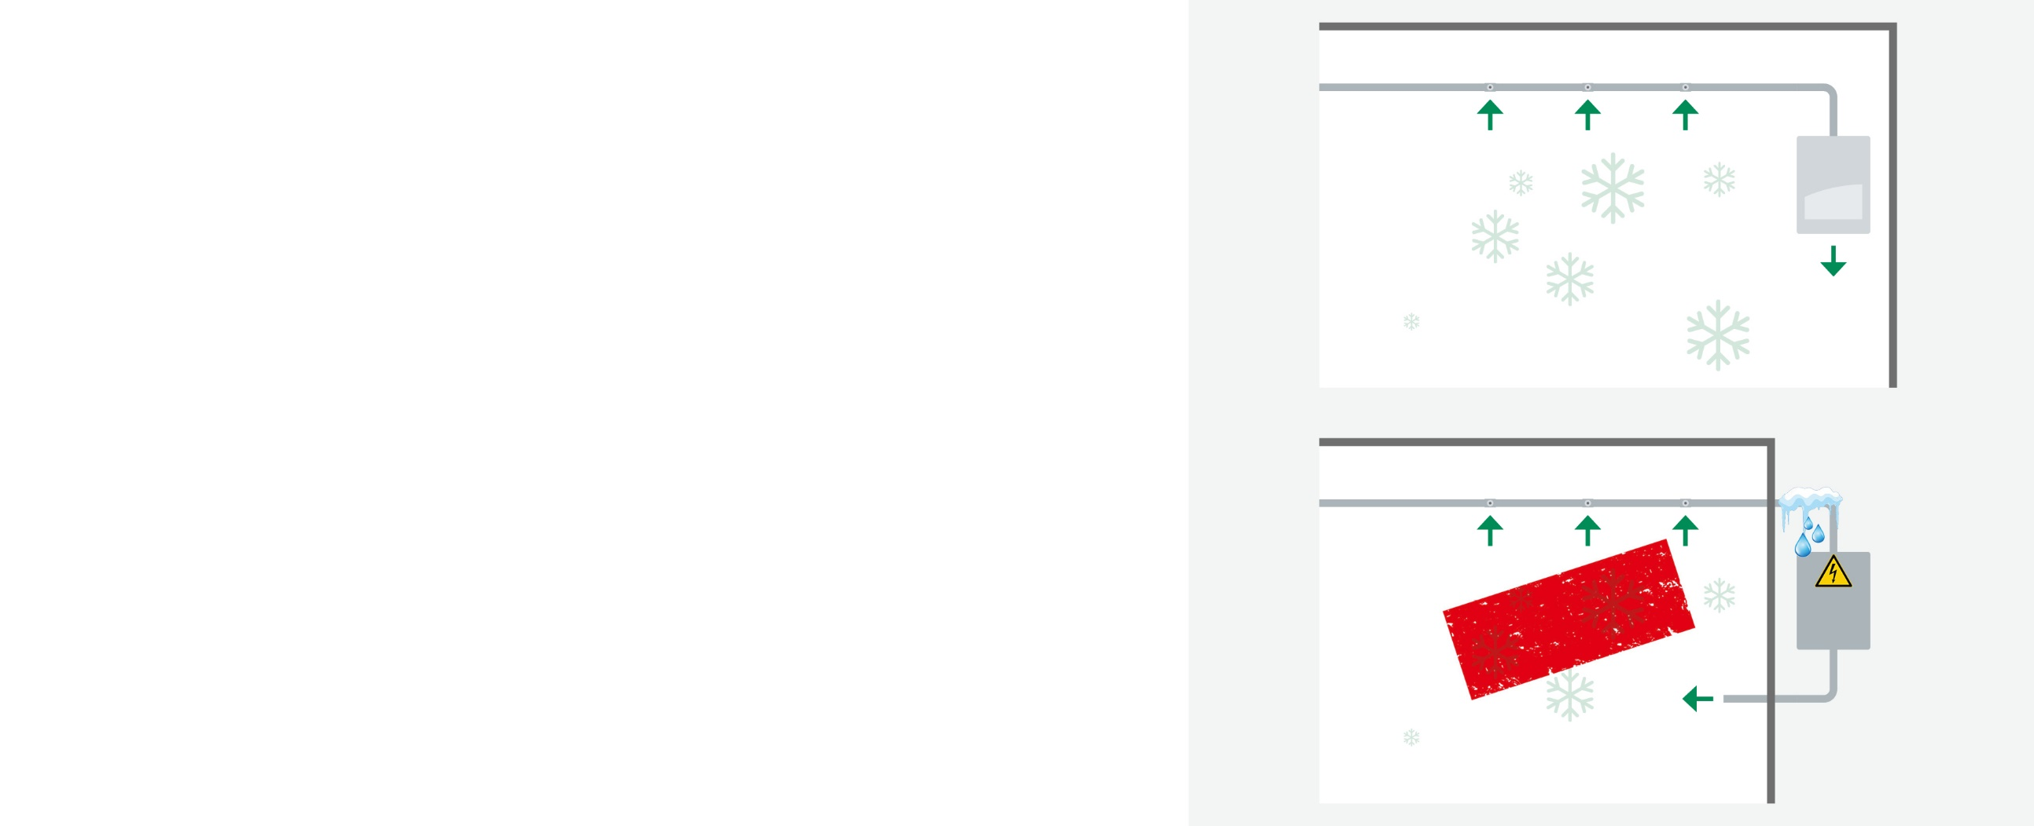
Deep freeze Areas
Installation within the deep freeze area
down to −40 °C, thus avoiding:
Condensation and ice formation on the pipe
Penetration of condensed water into the detector
Damage to the deep freeze area
Unnecessarily high installation costs
Below −10 °C:
Use of ABS, copper or stainless-steel pipe
−40 ºC
+20 ºC
WRONG
Standard ASD from
−10 ºC
−40 ºC

Slide 44
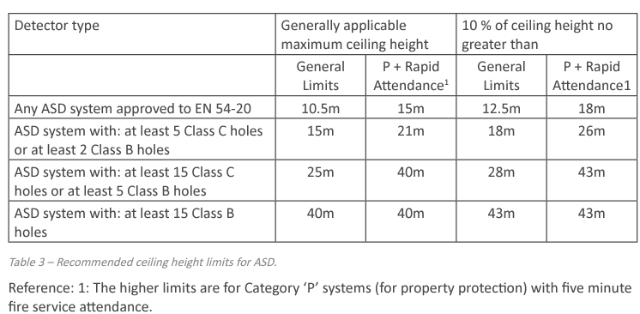


Warehouses Challenges
Ceiling heights
Stratification
  Small, low-energy fires are subject to stratification solely due to gradual cooling of the rising smoke plume
Ventilation
Maintenance access
The presence of high storage racks
Notes:
In public buildings, tall spaces with glazed roofing designs allow for natural lighting and provide an appealing connection to the outdoors. However, the solar radiation that enters through large expanses of glass can often generate thermal gradients within the space, resulting in a hot gas layer near the ceiling/roof. This can vary from day-to-day, depending on thermal load and operations of the buildings’ HVAC or natural ventilation systems. Smoke may not be buoyant or hot enough to penetrate the ceiling layer in such stratified hot layer environments, rendering spot smoke detection ineffective, if placed at or near the ceiling. Aspirating smoke detection systems, however, can be designed to avoid the issues posed for ceiling-mounted spot smoke detectors due to a solar induced hot layer.

Slide 45


Ceiling Detection
Ceiling mounted sampling points should be positioned above the aisles wherever possible, particularly where the rack height is >90% of the ceiling height.

Slide 46


High-bay Racking
For warehouses containing storage rack areas, it is recommended to place ceiling sampling holes above each aisle in a staggered layout
It is important to ensure that the pipes are not in close proximity to stored goods or installed in locations where they could be damaged by forklifts
Each aisle is treated as a smoke compartment when the storage racks extend to the ceiling, therefore ceiling sampling holes should be located above each aisle in the standard rectangular grid layout

Slide 47

In-Rack Detection
When installing drop-down pipes, it is important to ensure that they will not be damaged by forklifts or be in close proximity to the stored goods.
Fire Industry Association (FIA) recommends protecting warehouse high racking/shelving with air sampling points with a maximum horizontal spacing of 6 m (19.7 ft.), in order to reduce the possibility of smoke passing between sampling points
In case of racks height extend above 8 m (26.2 ft.), FIA recommends an air sampling top level within the top 25% of the rack height and no less than 10 m (32.8 ft.), from the ceiling.
Notes:
Thus racks where rack heights exceed ~10.5m are likely to require two levels of detection and racks over ~21m are likely to have three or more levels of sampling.

Slide 48

Positioning of Pipework and Sampling Holes
Position the pipework and sampling holes within the space between back-to-back shelving
Position the sampling holes at the shelving edge, adjacent to the aisles
Notes:
Aisle-side sampling is likely to provide more reliable and faster detection as it closer to the likely ignition source (eg vehicles in the aisles) compared to detection in the central ‘chimney’ (if present in the space between back-to-back shelving). However, while aisle-side sampling may be easier to install and test, it is more exposed to risk of mechanical damage. The decision needs to be on a case by case basis in the knowledge of the rack design, the fire risk of the materials stored and the operational activities.

Slide 49

Multi-level detection
is used in any of the following circumstances
There are high bay storage racking areas
High stratification levels are expected
Mezzanines (catwalks) consist of solid flooring that will impede/delay the ascend of the smoke plume

Slide 50


Parallel or Vertical Detection
Project planning rack storage
Project planning for aisle monitoring (ceiling area)
Front View
max. 3.3 m
7
7
6
6
max. 6.5 m
5
5
Without space between the racks
With space between the racks
4
4
max. 6.5 m
3
3
2
2
max. 6.5 m
1
1
max. 3.3 m
2,5 m
3,3 m
6.5 m
3,25 m

Slide 51




Fire Detection Solution Partner for Life
The Solution to exceed your expectations!
Thank you!

